Slide 1
Potty Training: Patience and Perspiration
Michael Messina, Psy.D., BCBA-D
Licensed Clinical Psychologist
Board Certified Behavior Analyst
RCOC Manager of Behavioral Services

Slide 2
The Truth about Toilet Training
It is extremely difficult
It is a dirty job
It is not for everyone
It may be easier for parents NOT to toilet train their child
It can take a REALLY LONG TIME
It takes a HUGE commitment from caregivers
It is an inconvenience
It could lead to other problem behaviors
It may be an ongoing process for maintenance

Slide 3
However, toilet training your child may…
Save parents time (in the long run)
Lessen parent stress
Save parents money
Be more convenient across various settings (i.e. community)
Enable the child to have more independence
Enable the child to have a better social life
Increase the child’s confidence
Make the child and family happier

Slide 4
Toilet training your child requires you to…
Get knee deep in it
Get your hands dirty
Dive in head first

Slide 5
“GET KNEE DEEP IN IT”
Toilet training requires a thorough understanding of several aspects related to toileting:
Biology
Cognitive functioning
Fine motor skills
Antecedents
Consequences
Topography of toileting routine
Times, locations, and frequencies
History

Slide 6
“GET YOUR HANDS DIRTY”
Parents must take a “Hands On” training approach.
This is active participation in helping the child with the toileting activity, changing the child, and/or being in the bathroom with the child.

Slide 7
“DIVE IN HEAD FIRST”
Toilet training really requires USING YOUR HEAD and being able to think on your feet.
Intervention strategies will be different for every child.
Intervention may change throughout training.
Toilet training requires creativity.

Slide 8
Five P’s of Potty Training
Priority
Preparation
Practice
Participation
Program

Slide 9
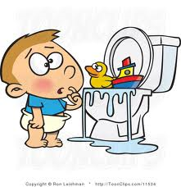
Priority
It is important to know when a child is ready to be toilet trained. While all that is listed may not be necessary to attain success, certain skills increase the likelihood of successful toileting.
Follow simple instructions
Developmental age of two
Able to pull up/down his/her pants
Can stay dry for a few hours at a time

Slide 10
Priority (cont.)
Shows some awareness of being wet
Dislikes being wet
Awareness of having a BM or urination (i.e. withdrawal, body positioning)
Regular BMs and no soiling during sleep
Stool should be normal in size and consistency. Soft, well-formed bowel movements are recommended. Should be no evidence of constipation or diarrhea. Child’s diet or medications may be a factor in stool formation. Contact medical doctor if stool withholding occurs

Slide 11
Priority (cont.)
Able to sit and hold body on toilet (may need adaptations)
No medical conditions or medication that make toileting impossible (may need medical evaluation)
Communicates need to use the bathroom or need to be changed

Slide 12
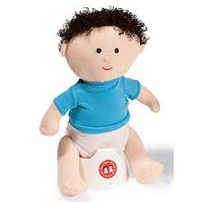
Preparation
Prepare your child
Model toileting for the child
Let the child observe parents or siblings using the toilet
Watch a DVD of toilet routine
Read books on toileting
Toileting dolls

Slide 13
Preparation (cont.)
Potty Training DVDs

Slide 14
Preparation (cont.)
Potty Training Books

Slide 15
Preparation (cont.)
Make toileting a comfortable experience.
A step stool so feet are not dangling and so that he/she is able to get on the toilet independently
A potty chair or adaptive seat
Make the room and toilet seat temperature comfortable

Slide 16
Preparation (cont.)
Make toileting a fun and pleasant experience
Have a favorite book or toy in the bathroom that the child only has access to while in the bathroom
Have music or a portable DVD player on while child is sitting on the toilet
Make a game out of toileting (i.e. sinking the Cheerios, lining the toilet with foil to make a noise)
Keep bathroom organized and clean to reduce distractions

Slide 17
Preparation (cont.)
In most cases, once you begin toilet training you should put away diapers and only use pull-ups or underwear
Have fun underwear with cartoon characters
Place underwear under pull-up so that child feels the wetness
Pull-ups should be slowly faded and underwear only should be used
If having a diaper or pull-up on is an antecedent to elimination, then a hole may be cut in the diaper and the child then placed on the toilet and prompted to go

Slide 18
Preparation (cont.)
A graduation ceremony may be held to teach the child that he/she has graduated from pull-ups and is a big boy/girl now that uses underwear. This ceremony may be important to have when beginning a toileting program
Child should wear clothes that are easy to pull down
Avoid snaps, buttons or zippers that may be too difficult for your child to undo

Slide 19
Practice
Address toilet sitting refusal
Utilize appropriate strategies to address other behavioral concerns related to toileting tasks (e.g., tantrums, physical aggression, etc.).
“Rewards with shaping” may be utilized to help child approach and sit on the toilet for a longer time (i.e. start with 10 seconds, then go to 20 seconds, etc.). A timer may be used.
Don’t make your child sit for too long

Slide 20
Practice (cont.)
Keep your language simple and consistent
All caretakers should use the same words, such as “pee-pee” or “poo-poo”
Use short simple phrases, such as “sit on toilet” or “go pee-pee”
Remain neutral if your child has an accident.
Do not utilize punishment or negative reactions if your child has an accident.
Remind him/her that pee or poo goes in the toilet

Slide 21
Practice (cont.)
Utilize a Task Analysis
May want to sequence the steps involved in toileting in a series of photos or pictures
Review this with your child before, during and after toileting

Slide 22
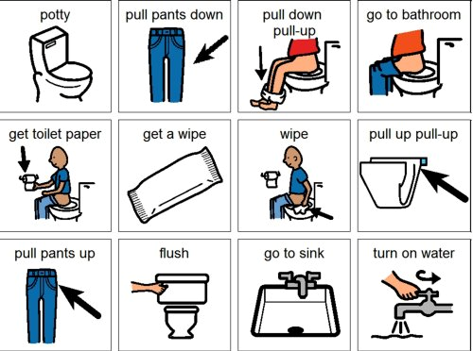
Practice (cont.)
Task Analysis

Slide 23
Practice (cont.)
To increase the likelihood that your child will let go while on the toilet:
Provide your child with water 15 minutes before toileting prompt
Turn on running water in bathroom
Sit your child on the toilet according to his/her typical elimination pattern

Slide 24
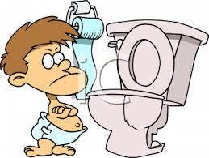
Participation
Don’t make toileting an aversive task
Don’t force your child
If your child is not ready you may need to wait a few weeks and then reintroduce the subject
Forcing your child will make the experience more aversive and he/she may develop a fear of toileting
Do not flush the toilet while your child is still on the toilet

Slide 25
Participation (cont.)
Have your child participate in the clean-up/changing process
Have him/her clean up if possible
Have him/her throw away dirty diaper
Have him/her pull up his/her own pants
Have him/her empty own diaper into toilet
Complete all toileting activities in the bathroom
Don’t make it fun!

Slide 26
Program
Take data on a “Toileting Schedule”
Establish baseline and notice patterns
Maintain a toileting routine based on data collected
Remember the natural opportunities for toileting, such as upon waking up, before bathing, before a preferred activity, before leaving the house or transitioning, and before going to sleep
A timer may be used

Slide 27
Program (cont.)
Rewards should be used for dry/clean pants, urination on toilet, and/or BM completion on toilet
A visual monitoring system is recommended
Use self management if possible
www.rewardcharts4kids.com
www.freeprintablebehaviorcharts.com
www.kidpointz.com

Slide 28
Program (cont.)
Once child is no longer having daily accidents, self-initiation skills can be targeted.
Reward self-initiation to the toilet.
Gradually fade out parent prompts.

Slide 29
Program (cont.)
Bed-wetting:
Much of the same interventions apply, however, successful toileting patterns during waking hours is needed before bed-wetting can be addressed
Limit amount of fluid child has to drink before bed
Have your child void before bed
The bell/pad technique
Wake child up to use the toilet
Rewards can be used for staying dry all night

Slide 30
Case Examples
What to do when the basics fail…

Slide 31
Dale
6 year old male diagnosed with PDD NOS
Fully verbal and ambulatory
Urinates standing and completes all activities associated with urinating (i.e. initiation, pulling up and down pants, hand washing, etc) independently at home and at school

Slide 32
Dale (cont.)
Normal BM almost every day in the evening (sometimes every other day) at home in between 4:00pm and 8:00pm.
No BMs at school or other places in the community.
Wears regular underwear throughout the day.

Slide 33
Dale (cont.)
Initiates BMs by obtaining a pull-up for himself from the bathroom cabinet.
After removing pants independently, he independently places the pull-up on and completes a BM shortly thereafter.
The BM sometimes occurs while still in the bathroom, and sometimes occurs after he has left the bathroom.
Following BM, he will sometimes resume the activity that he was engaged in prior to the BM (i.e. playing)

Slide 34
Dale (cont.)
Does not always seem to mind sitting in a soiled pull up, although will sometimes tell his mother that he had a BM.
When a parent realizes that he had a BM (e.g., because he tells the parent or because the parent senses the odor), the parent will require that he remove his own pull up, clean himself, place back on his clean clothes, throw the pull-up in the trashcan, and wash his hands.
He usually complies with the clean up routine independently following these instructional cues, however, sometimes needs assistance (i.e. parent does it for him rather than hand-over-hand) getting completely clean.

Slide 35
What do you do?

Slide 36
Marco
7 year old male diagnosed with Autism
Mostly non-verbal and fully ambulatory
Urination accidents multiple times daily
No attempt to use the bathroom or tell his parent that he had an accident
Wears a pull up all day, daily.

Slide 37
What do you do?

Slide 38
Questions?

Slide 39
Thank you!
Dr. Michael Messina
(714) 796-5225
mmessina@rcocdd.com

