Slide 1


Transition Planning
Creating a Life Full of Possibilities
Fall 2016 #1

Slide 2
Presenters
Linda O’Neal, M.A.
Janis White, Ed.D.
Chief Operating Officer, Regional Center of Orange County
Arturo Cazares
Employment & Day Services Manager Regional Center of Orange County
Regional Center of Orange County- Consultant
SDSU Program Specialist
Transition Specialist 30 Years
Special Educator K- 12 & Community College
Chapman University: Thompson Policy Institute Co-Chair Regional Business Advisory Committee

Slide 3
AGENDA
Welcome and Webinar Process
Transition Challenges
Employment First Initiatives
Competitive Integrated Employment
Power of Person Centered Planning
Transition Planning & The ITP
Parent/Family Engagement
Workplace Learning & Employment
Self-Advocacy & Empowerment
New Work Training Opportunities
Recreation, Socialization & Fitness
Education
Recreation
Agencies
Work
Mobility
Home
TRANSITION PLANNING

Slide 4
National Statistics
Social Security Administration
Each year 7.5 million Americans with disabilities draw $73 billion from the Social Security Administration (SSA)
… less than 1% of these individuals ever become self-supporting through employment

Slide 5
National Statistics (cont…..)
Individuals with disabilities are twice as likely to drop out of school
Only 35% of adults with disabilities are employed, while 78% of those without disabilities are employed
Three times as many individuals with disabilities live below the poverty line
Notes:
The statistics about individuals with severe disabilities are even more dire.

Slide 6
Transition Challenges
Studies on individuals with disabilities indicate:
Lower high school graduation rates
Lower college entrance & graduation rates
Higher rates of poverty (29% live on household incomes of less than $15,000)
70%-89% unemployment (depends on the source)
Under-employment
Less life satisfaction (socialization & optimism)

Slide 7


Employment First
…The full inclusion of people
with the most significant disabilities
in the workplace and community (with)
community-based, integrated employment as the first option ...
Integrated competitive employment refers to jobs held by people with disabilities in typical workplace settings where the majority of persons employed are not persons with disabilities, they earn at least minimum wage and they are paid directly by the employer.
http://www.dol.gov/odep/topics/EmploymentFirst.htm

Slide 8

Employment Nationally
Department of Justice has sued 3 states to close sheltered workshops and segregated day programs:
  Oregon
  Delaware
  Rhode Island
Was 26 now 46 states have something akin to Employment First Policies*
  Was 14 now 32 States have a formal policy action
  12 States have passed legislation
  *Association of People Supporting Employment (APSE) 2016
Notes:
Latest RI. national movement in invoking the Olmstead Act to move people out of large institutions. One of the last institutional settings is the sheltered workshop.
A summary of the status of Employment First nationally is as follows:
• Employment First efforts have been identified in 42 states.
• Twenty-six states have been identified that have something akin to an official Employment First policy (based on legislation, policy directive, etc.). Twelve states have passed legislation: California, Delaware,
Illinois, Kansas, Maine, North Dakota, Ohio, Pennsylvania, Texas, Virginia, Utah, and Washington.
The other 14 (Arkansas, Colorado, Connecticut, District of Columbia, Louisiana, Maryland, Massachusetts, Missouri, New Jersey, Oklahoma, Oregon, Rhode Island, Tennessee, Vermont) have a policy directive, Executive Order, or similar official policy statement, but not legislation.
• Eleven of these policies are cross-disability: Arkansas, Delaware, District of Columbia, Illinois, Kansas, Maine, New Jersey, North Dakota, Texas, Virginia, and Utah. The remainder of states with policies, have policies that focus exclusively on individuals with intellectual and developmental disabilities: California, Colorado, Connecticut, Louisiana, Maryland, Massachusetts, Missouri, Ohio, Oklahoma, Oregon, Pennsylvania, Rhode Island, Tennessee, Vermont, Washington.
• In addition to the 26 states with Employment First policies, the other 16 states on this list (Alabama, Florida, Georgia, Idaho, Indiana, Iowa, Kentucky, Michigan, Minnesota, Mississippi, Nevada, New Mexico, New York, North Carolina, South Dakota, Wisconsin) have Employment First efforts and initiatives underway, but at this point it appears no official Employment First policy has been issued. It is important to recognize that the presence or lack of presence on this list of any state should not necessarily be an indicator regarding the state’s focus on employment for people with disabilities. There are a number of states that have not been linked with Employment First, who have consistently had relatively strong outcomes in terms of employment of people with disabilities. However, the emergence of Employment First as a national movement has served as a catalyst for an increased focus on employment of people with disabilities across the United States.
In the course of developing this document, the focus has been on including as many examples as possible, particularly in terms of resources from individual states. The underlying rationale for doing so is to provide an understanding of the wide range of approaches to Employment First. Inclusion of specific policies and documents on this list should in no way be viewed as an endorsement of these documents, and in fact, the Employment First legislation/policies that have been developed vary significantly in terms of the strength and clarity of their language. The wide range of attention and emphasis on Employment First has been encouraging, and provides a potential catalyst for the long needed increase in workforce participation for individuals with disabilities. At the same time, it is important to recognize that creation of documents, reports, and policies, in and of itself, will not result in increases in workforce participation, without a long-term commitment to action steps that make the Employment
First vision a reality for all citizens with disabilities. Setting a vision and direction is a starting point – but it must be done in conjunction with comprehensive systems change that results in shifting of resources towards integrated employment, a service system that provides consistent and high quality employment assistance and supports, and measurement and accountability for achieving employment outcomes. Employment First is also about more than just simply changing how services and supports for people with disabilities are provided – it is a catalyst for and reflective of an ongoing fundamental cultural shift and view by policymakers, public officials, service systems, service providers, employers, and most importantly by individuals with disabilities themselves, that views people with disabilities as full participants in the economic mainstream, working side-by-side with their fellow citizens.

Slide 9
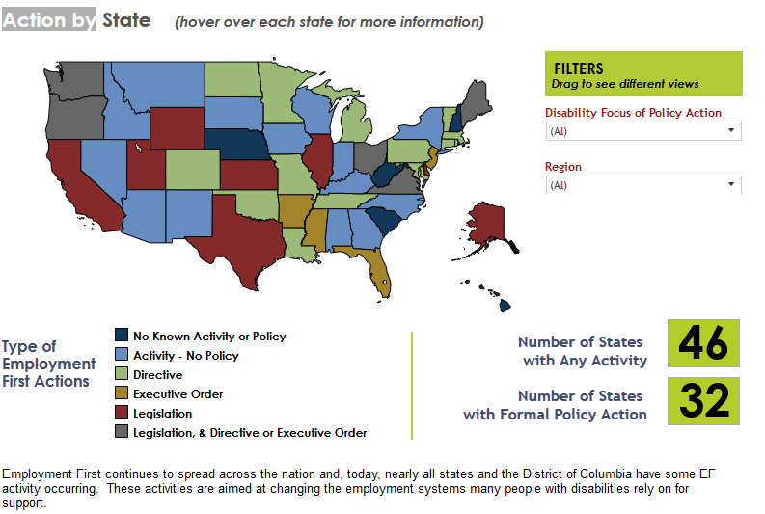
http://www.apse.org/wp-content/uploads/2014/01/activity.html

Slide 10

http://www.rehab.cahwnet.gov/Public/CIE-MOU.html

Slide 11




FEDERAL ADVISORY COMMITTEE ON INCREASINIG COMPETITIVE INTEGRATED EMPLOYMENT FOR INDIVIDUALS WITH DISABILITIES
September 2014-2016

Slide 12
The Advisory Committee on Increasing Competitive Integrated
Employment for Individuals with Disabilities (the “Committee”) was established under Section 461 of the Workforce Innovation and Opportunity Act (WIOA) signed into law on July 22, 2014, to advise the Secretary of Labor and Congress on:
• Ways to increase employment participation of individuals with intellectual or developmental disabilities (I/DD) and other individuals with significant disabilities through opportunities for competitive integrated employment (CIE);
• The use of the certificate program carried out under Section 14(c) of the Fair Labor Standards Act (FLSA) for employing individuals with I/DD and other individuals with significant disabilities, including ways to improve oversight of such certificates.

Slide 13
Competitive Integrated Employment
Work performed on a full or part-time basis (including self-employment) for which an individual is:
1. Compensated at not less than federal minimum wage requirements or state or local minimum wage law (whichever is higher) and not less than the customary rate paid by the employer for the same or similar work performed by other individuals without disabilities;
2. At a location where the employee interacts with other persons who do not have disabilities (not including supervisory personnel or individuals who are providing services to such employee) to the same extent that individuals who do not have disabilities and who are in comparable positions interact with other persons; and
3. Presented, as appropriate, with opportunities for advancement that are similar to those offered other employees who are not individuals with disabilities and who have similar positions.

Slide 14
Recommendations Year #1:
Increase opportunities for Post Secondary Education
Address family expectations for Competitive Integrated Employment (CIE) from early age
Increase opportunities for early Integrated Work Experiences beginning at age 14
Improve professional supports & incentives by improving school & provider competencies

Slide 15
USDOL Recommendations Year #1
Continued:
Address concerns regarding real & perceived disincentives to employment caused by concerns for loosing benefits
Address systemic low expectations by providing effective CIE practices
Improve accountability for achieving CIE
Build better business partnerships
Address complex transportation issues

Slide 16
USDOL Recommendations Year #2
For youth to effectively transition to adult employment there needs to be...
Early Work Experiences
Family Expectations, Involvement & Support
Professional Development & Training
Systems Integration & Seamless Transition
Available & Transferable Assistive Technology

Slide 17
Building Capacity in the Marketplace
Increased business & employer engagement will be necessary to increase CIE...
1. Increased and more effective communication and outreach to businesses,
2. Specific business-oriented professional development for employment services personnel,
3. Incentives to create work experiences as preludes to employment,
4. Expansion of available benefits counseling and financial coaching,

Slide 18
Building Capacity in the Marketplace
Increased business & employer engagement will be necessary to increase CIE, continued...
5. More accessible transportation,
6. Hiring initiatives in high-growth industries, particularly healthcare,
7. Additional outreach to federal contractors regarding the Office of Federal Contract Compliance Programs (OFCCP) Section 503 regulations which establish disability hiring goals, and
8. Revisions to federal tax incentives and credits available to employers who hire people with disabilities.

Slide 19
CONCLUSIONS...
The work of the Committee, and the formation of its recommendations, was intended to increase opportunities for CIE for individuals with I/DD or other significant disabilities. Ensuring that CIE is the first option for people with I/DD or other significant disabilities will increase their employment participation rate and lead to a significant reduction in segregated work and non-work programs and in the use of Section 14(c) certificates for paying subminimum wages. CIE will create a critical pathway to better economic future and increased economic self-sufficiency for youth and adults with disabilities.

Slide 20
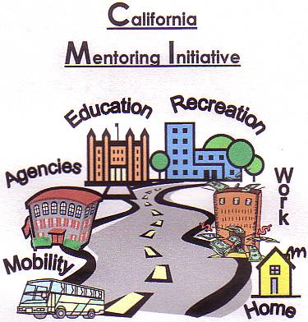
Transition Planning

Slide 21
Transition Planning Mission
…to empower all individuals with disabilities with the skills necessary to achieve their full potential in adult living, through support and collaboration with families, education, and communities.

Slide 22
The Law: Individuals with Disabilities Education Act (IDEA) Secondary Transition
Focus:
  Improve academic and functional achievement to facilitate movement from school to post-school activities
  Based on youth’s strengths and interests
  Includes instruction, related services, community experience, development of employment, and other post-school living objectives
  Mandates the development of a plan that summarizes skills, strengths, transition readiness, need
Notes:
Secondary Transition as defined in IDEA

Slide 23
Constructing the Transition IEP/ITP
Annual Age Appropriate Assessment
Post-Secondary Goals
Coordinated Set of Activities
Measurable Annual Goals
Course of Study
Post-Secondary Outcomes
Student Interests, Dreams
Family Input / Needs
Notes:
While the elements of a compliant IEP are listed numerically, for the purposes of this training, we are going to construct the IEP in a logical sequence and share resources for each section.

Slide 24
Transition Services
Begin no later than the first IEP in effect before the child turns 16
Younger if determined appropriate by the IEP Team
Updated annually
Measurable postsecondary goals
Age appropriate transition assessments
  Education/training
  Employment
  Independent living when appropriate
Course of study needed to reach the child’s goals
Child informed of rights one year prior to age of majority
[34 CFR 300.320(b)(c)] [20 U.S.C. 1414(d)(1)(A)]
Notes:
Transition services are required by the child’s 16 birthday. It is recommended that they begin no later than age 15.

Slide 25
Post-Secondary Goals
All students must have a postsecondary goal for:
Education/training
  Education: community college, university, technical, trade or vocational school
  Training: vocational or career field training, independent living skills training, apprenticeship, job corps, etc.
Employment
  Paid employment (integrated, competitive, supported, center-based)
  Non-paid employment (volunteer, internship)
  Military
Some students will need a postsecondary goal for:
Independent living (best practice – all students will have a goal in this area)
  Adult living, social relationships, recreation, leisure, health, safety, financial management, transportation/mobility, self-advocacy
Notes:
The National Post-school Outcomes Center has defined post school outcomes.

Slide 26
Education/Training

Slide 27
When Developing the Postsecondary Education and Training Goal, Consider the Array of Options for Postsecondary Education and Training
College and Career Readiness
Career/Job information informs the need for postsecondary education that includes:
College: University and Community College
Occupational Certification
Technical Training
Industry Certification
On the Job Training
Did you know that traditional college/universities only provide 35% of the post-secondary education?
Notes:
Frequently the focus is on postsecondary education at the college and university level. There are an array of other options.

Slide 28
Post-Secondary Training…
High school completion document or certificate classes (e.g., Adult Basic Education, General Education Development (GED)
Short-term education or employment training program (e.g.,
Workforce Innovations & Opportunities Act (WIOA)
Job Corps
Vocational technical school which is less than a two year
program
Adult Education Block Grant Adult AB 104
K-12/Community College Partnerships

Slide 29
Employment

Slide 30
Preparing for a Job & a Career…
Start Early
Developing employment related skills from a very early age
Participating in Work-Based Learning Experiences in integrated settings in the community starting
Prepare for jobs in competitive integrated employment settings.
It’s never too late to develop skills to promote improved life outcomes!

Slide 31
Current Work Training Programs in the OC
Orange County School Districts
Workability I /School Districts (WA1)
Transition Partnership Projects (TPP) /School Districts
College 2 Career (C2C) /North Orange County Community College District)
Workability III /North Orange County Community College District)
Adult Service Providers
Adult Education Block Grant Programs through AB 104 through Community Colleges
American Job Centers (AJCs)

Slide 32
Independent Living

Slide 33
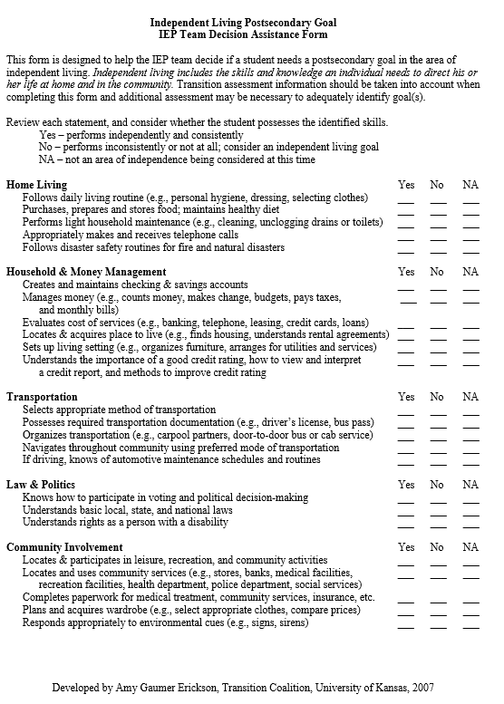

Slide 34
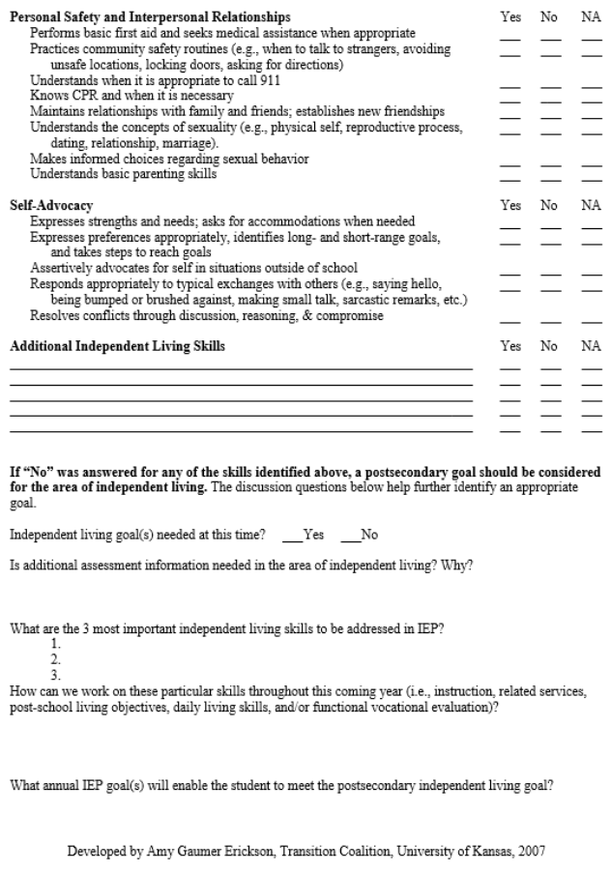

Slide 35

http://www.rcocdd.com/wp-content/uploads/Spring2016Transition-Planning-The-Basics-2016.pdf

Slide 36
The Guide - Transition Planning: The Basics
Intent: to develop a resource that summarizes mandates
Recognize transition is a process, not a document
Verify increasing focus on research and evidence-based best practices that have been validated as helpful in achieving outcomes
Use as a planning tool: evaluation of current practice and potential areas of improvement
Designed to show the connection between the mandate and using research to achieve outcomes
Highlights an array of evidenced-based practices, tools and resources
Is researched-based
Available to download on the RCOC Website http://www.rcocdd.com/wp-content/uploads/Spring2016Transition-Planning-The-Basics-2016.pdf
California Transition Alliance, Sue Sawyer, 2016
Notes:
The purpose of the guide is to provide easy access to resources that can be used by parents, educators and agency partners.
As regulations and expectations change, the California Transition Alliance is committed to routinely updating it.

Slide 37
Student Participation in the IEP
The Transition Coalition identifies five levels of student participation in the IEP:
Student input provided indirectly based on a questionnaire or survey.
Passive observer (in the room, avoids the conversation).
Reluctant participant (responds to direct questions).
Self-advocate (practices self-advocacy skills).
Leader (demonstrates leadership skills in the IEP).
Notes:
The goal of the school should be to get the student from a passive observer during the IEP to actually leading their own IEP.
This requires training. This training should be part of the transition program.

Slide 38
Self Advocacy

Slide 39

Self-Advocacy means taking the responsibility for communicating one’s needs and in a straightforward manner to others. It is a set of sills that includes:
Speaking up for yourself
Communicating your needs and wishes
Being able to listen to the opinions of others, even when their opinions differ from yours
Having a sense of self-respect
Taking responsibility for yourself
Knowing your rights
Knowing where to get help or who to go to with a question
http://www.pacer.org/transition/

Slide 40
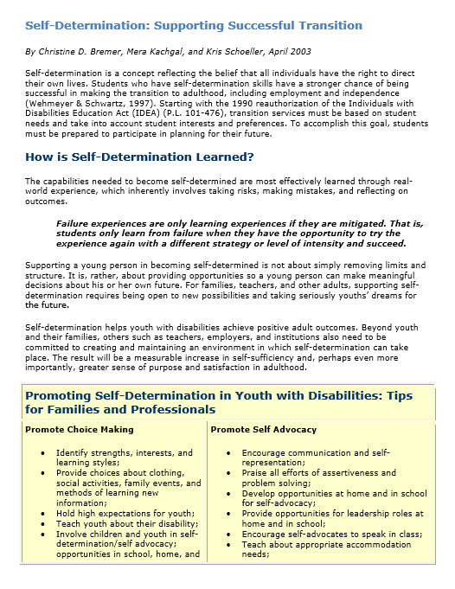

Slide 41
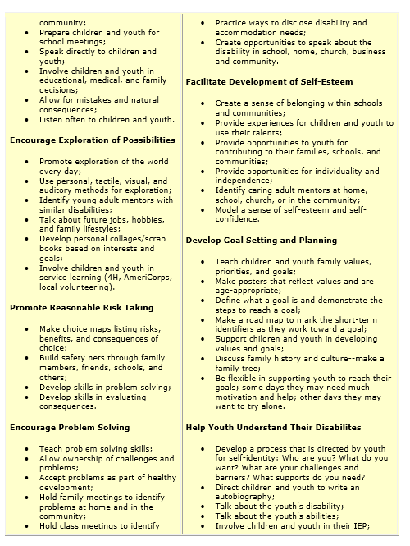

Slide 42
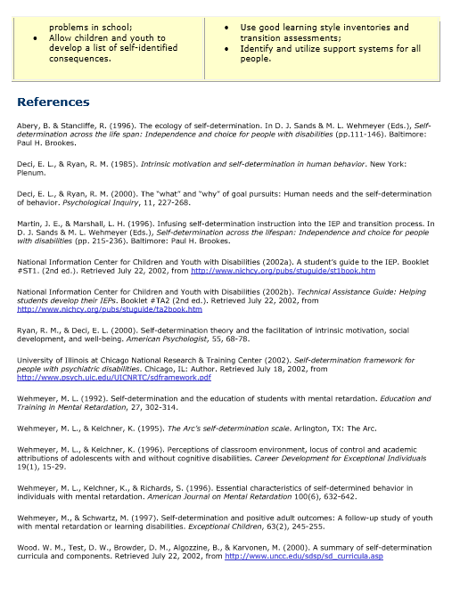

Slide 43
Age of Majority
When a child reaches the age of majority, he/she should:
18 Years Old
Understand their disability
Advocate for themselves
Understand why they receive special education services
Participate/lead their IEP meetings
Be involved in the interpretation of test results
Review their educational records
Know their rights under Section 504 and ADA
Notes:
Age of Majority is a legal definition.
However, the Age of Majority implications validate the need for self advocacy and self determination skills.

Slide 44

In-School Predictors by Post-School Outcome Area
Predictors/Outcomes | Education | Employment | Independent Living
Career Awareness | X | X
Occupational Courses | X | X
Paid Employment/Work Experience | X | X | X
Vocational Education | X | X
Work Study |  | X
Community Experiences |  | X
Exit Exam Requirements/High School Diploma Status |  | X
Inclusion in General Education | X | X | X
Program of Study |  | X
Notes:
The National Secondary Transition Technical Assistance Center (NSTTAC), which is funded by the Office of Special Education Programs (OSEP), has done research on predictors and practices that lead to positive post-school outcomes.
Research has shown that when youth participate in the in-school predictors listed here, there is strong evidence of post-school success in the areas of education, employment and/or independent living.
Note that students who participate in paid employment/work experience and are included in general education have demonstrated post-school success in all three areas.
Why do you think that is so?
44

Slide 45

In-School Predictors by Post-School Outcome Area
Predictors/Outcomes | Education | Employment | Independent Living
Self-Advocacy/Self-Determination | X | X
Self-Care/Independent Living | X | X | X
Social Skills | X | X
Interagency Collaboration | X | X
Parental Involvement |  | X
Student Support | X | X | X
Transition Program | X | X
National Center Secondary Education & Transition www.ncset.org
National Center on Secondary Education & Transition www.ncset.org
Notes:
Note that self-care/independent living and student support also show positive outcomes in all 3 areas.
There’s a direct relationship between student outcomes and school experiences.
We have responsibility for students’ school experiences.
By improving transition planning, we can improve the post-school outcomes of youth.
If you would like more information about the state performance indicators please refer to the websites on the Resources handout, State Performance Plan section on page 1.
45

Slide 46

Parent/Families Perspective
Concerns
Support for Employment
Family Involvement & Support

Slide 47
Parent Concerns
Dislike job or internship
  “Too easy” or “Too hard”
Afraid to let their child be independent
  Go out into the community
  Use public transportation
  Have a bank account / ATM Card
Surprise job site visits (Don’t do it!)
Vacation and Holidays
  Need to be prepared to meet employer expectations
Afraid son or daughter will lose (SSI/SSDI/Medi-Cal/ Medicare) benefits if they participate in a paid job
47
Notes:
47

Slide 48
Family Buy-in & Support
Willingness to consider Competitive Integrated Employment (CIE)
Encourage as much independence in your student as early as possible.
Education is a collaborative process
Willing to learn about Benefits Planning & Management
Learn about the various community resources & services
Support work on the weekends, evenings & holidays

Slide 49
Parent Support for Employment
Encourage student to consider a realistic and viable career ladder job
Consider labor market needs in local area
Research career options to help your student make good choices for him/herself
Consider transportation options to potential work sites
Know and understand the American’s with Disabilities Act (ADA)
Assist student in understanding required accommodation needs to support execution of the essential functions of the desired job
Request job coaching support through school & adult programs (Workability I, TPP, C2C, WIOA, etc.)

Slide 50
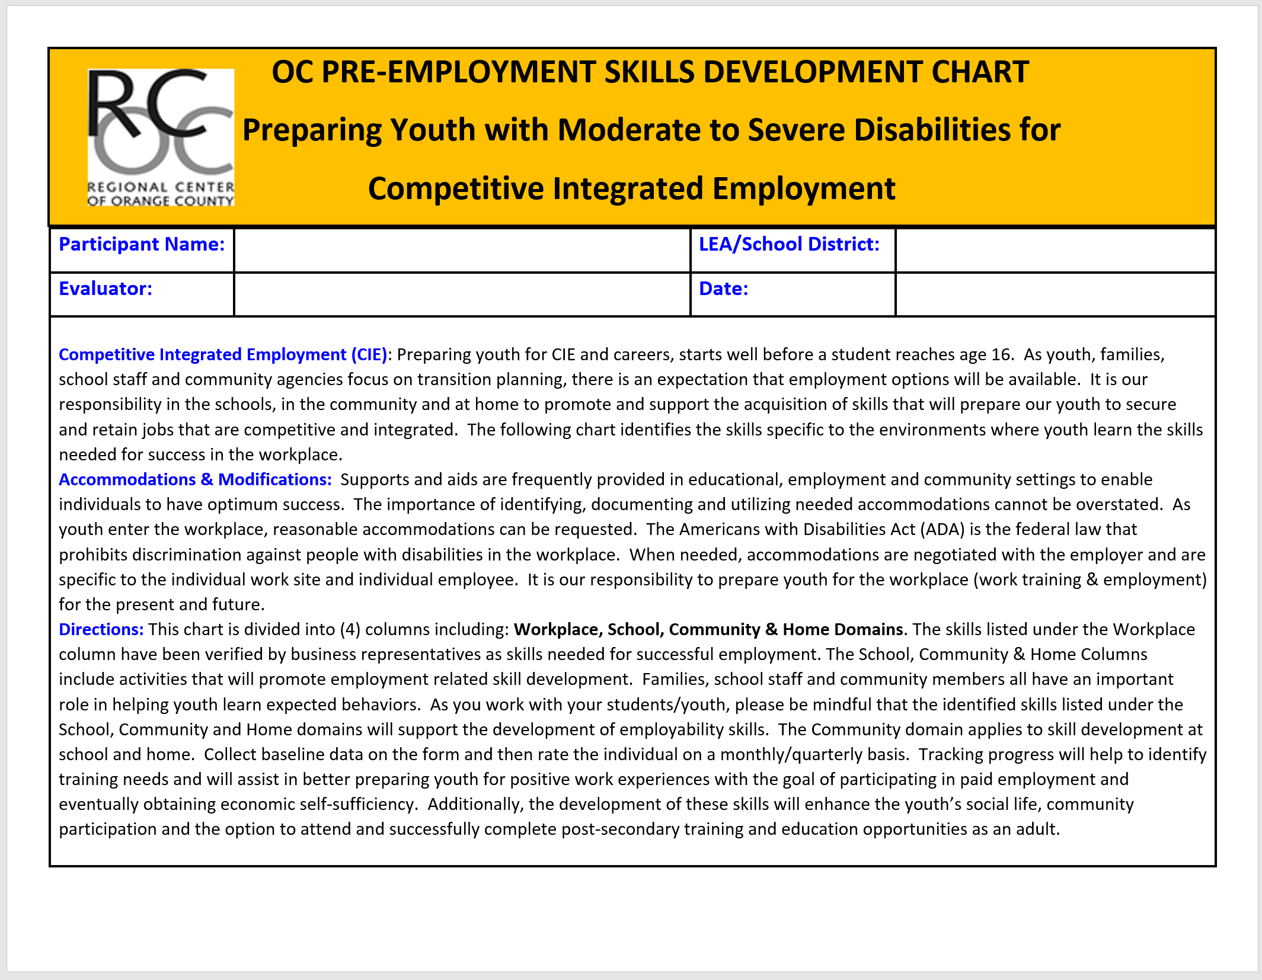

Slide 51
Pre-Employment Skills
Follows Directions
Dress/Hygiene
Time Management
Work Tasks
Productivity/Quality of Work
Communication/Socialization
Utilizing Natural Supports
Mobility/Community Safety/Transportation

Slide 52

New Work Training Programs in Orange County
Project Search CHOC Children’s Hospital /Adult Program
AB 104 Adult Education Block Grant Programs (Community College & K-12 Partnerships)
Career Pathways Programs Orange County Department of Education
Workforce Innovations & Opportunities Act
(WIOA Youth Providers & Department of Rehabilitation WIOA Programs)
Currently being developed...
Project Search UCI Medical Center
Jay’s Catering (Youth & Adult Program)
Project Search Medtronic /Adult Program

Slide 53
The Individualized
Approach

Slide 54

Community Safety
Cell phones with GPS
Community Safety Training
Stranger avoidance
Street & parking lot crossing
Mobility/Travel Training
Public Transportation
Para Transit
Job Coaches (well-trained)
Notes:
54

Slide 55
Transportation Plan
Public Transportation/Travel Training
Walking
Bike
Para-Transit
School provided transportation
Parent provided transportation
Car Pool /Employer Van Pool
55
Notes:
55

Slide 56
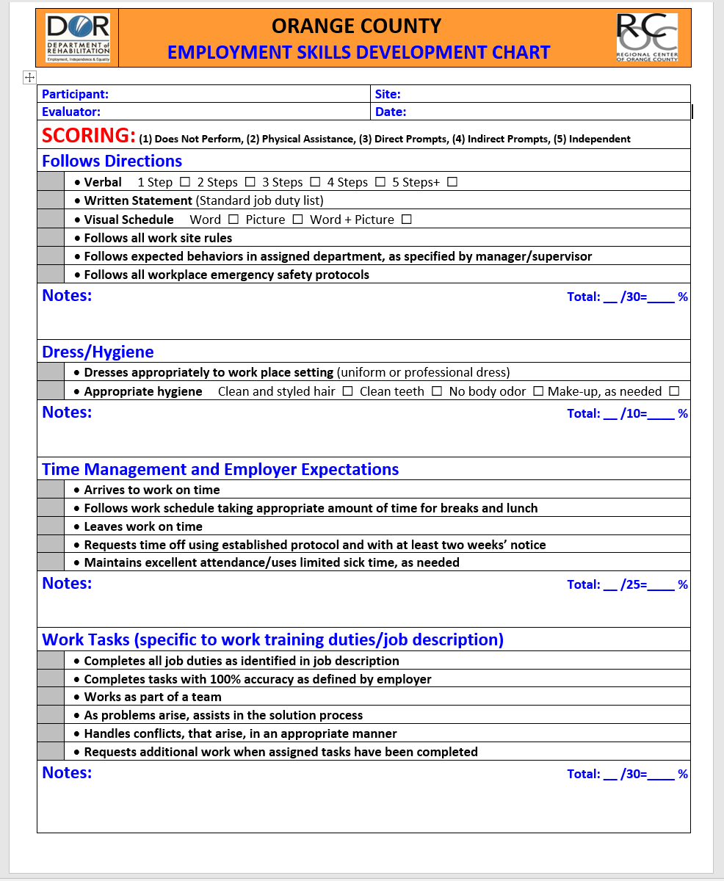

Slide 57
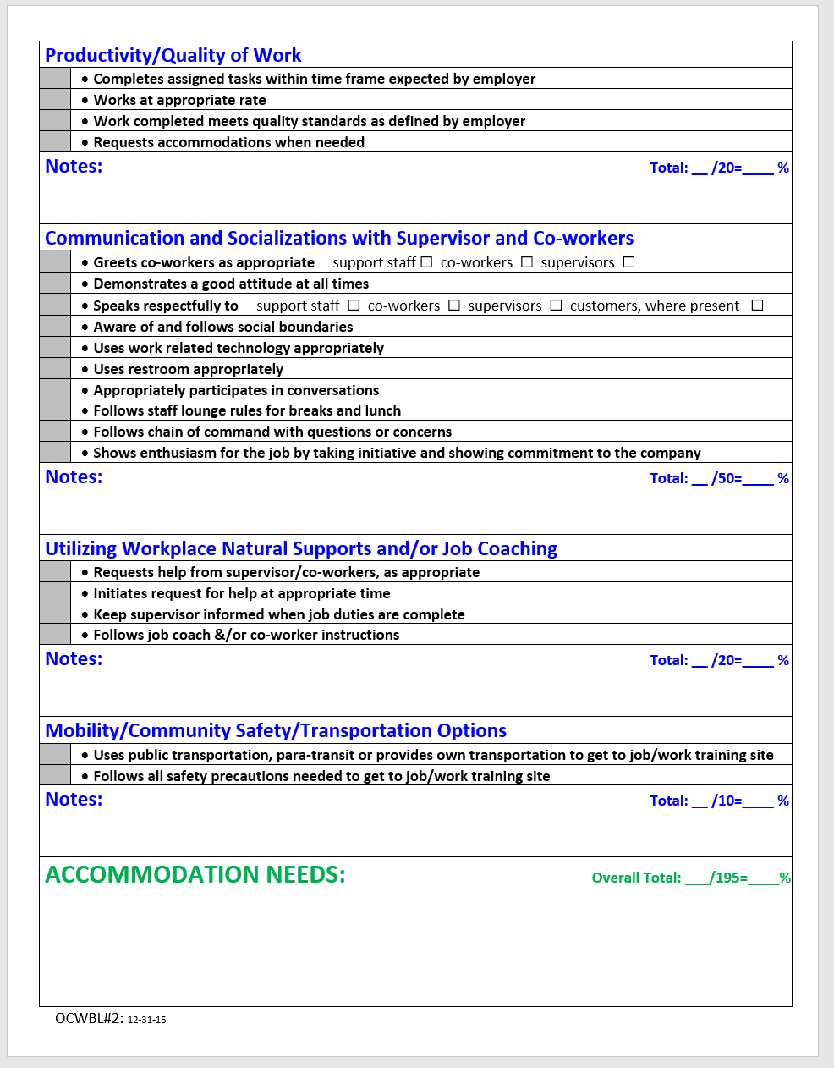

Slide 58


















Orange County Top Employers

Slide 59

Successful Work Experience & EMPLOYMENT $ (Direct Hire)
Locations:
Food Service
Clothing/ Retail
Education, other
McDonalds$
Marshalls $
Pizza Hut
Chili’s
Red Robin
Culinart
Lampost Pizza
Pieology
Party City$
Office Maxx
REI $
Irvine Valley College
Heritage Park Library
Pretend City
Incredible Edible Garden
Codan
Families Forward
Aramark Sports Entertainment $
AMC Theaters $
Darna Restaurant $
Carl’s Jr. $
Regal Cinema $
Del Taco $
IUSD, ECLC
Fishbone Grill
Sears $
Target $
Chick Fil A

Slide 60
Technology, Hardware, Grocery
Technology:
Best Buy
Hardware, Specialized Trades:
Armstrong Garden Nursery
Grocery:
CVS$
Office Maxx
Walgreens $
Walmart $
Sprouts Market $
Sam’s Club $
Wholesome Choice
Trader Joes$
H Mart
Smart & Final$
Stater Brothers $
Ralphs $
Afakori Welding$
Home Depot $
Notes:
This is a small Example of some of the successful corporate business partners we have developed. If you share these locations with others in your office, or other neighboring school districts, we then are all working together to place our participants into jobs in our communities.

Slide 61
Caregiving, Pets, Hospitality
Caregiving:
Silverado Senior Living
Pets:
Petco
Hospitality:
La Quinta Hotels
CHOC
Atria Senior Living$
Woodbridge Manor
Boys and Girls Club$
Betsy’s Day Care
Pet Supply
Stonecreek Animal Hospital
City of Irvine Animal Shelter
Russo’s
The Pet Pantry
Candlewood Suites
Radisson Hotels
Hyatt Hotels $
Ayres Hotels
Hoag Hospital
Doubletree Hotel
Wyndham Hotel$
St. Michael Hospice
Disneyland $
Notes:
This is a small Example of some of the successful corporate business partners we have developed. If you share these locations with others in your office, or other neighboring school districts, we then are all working together to place our participants into jobs in our communities.

Slide 62
Recreation, Socialization & Fitness
School Clubs & Organizations
Special Interest Community Clubs or Athletic Teams
Best Buddies
YMCA New Horizons
Special Olympics
Community Options (Everyone Welcome)
Fitness Memberships
Professional Games
Events (Concerts, Volunteer Events to Give Back or Help your Community)

Slide 63
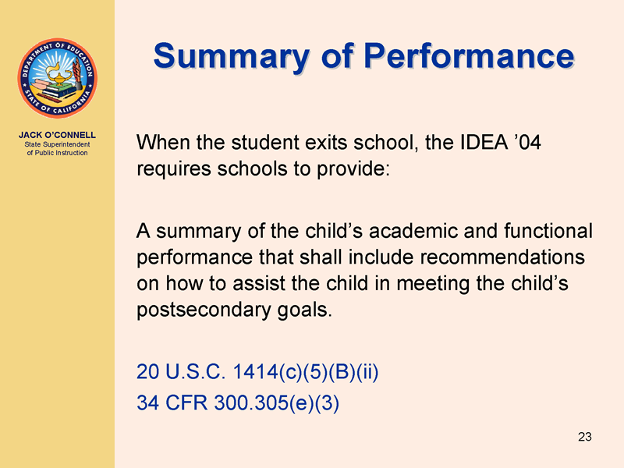
63
Notes:
63

Slide 64
Summary of Performance
SOP
The purpose is to assist students in accessing services and supports after high school
(higher education, training, employment and independent living)
Summary of academic achievement and functional performance
Recommendations on how to assist the student in meeting his/her post secondary goals
Accommodations, modifications and assistive technology
64

Slide 65
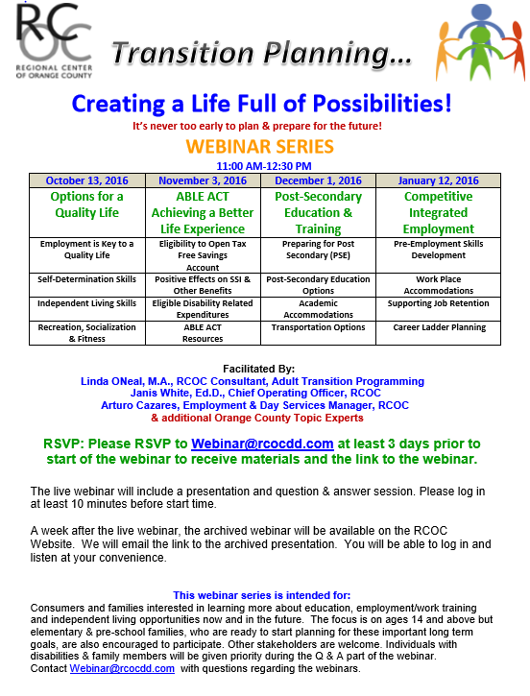

Slide 66


Recommended TV SHOWS
Speechless, ABC, Wednesday at 8:30 PM
A television series that debuted on September 21, 2016. ABC’s “Speechless” brings cerebral palsy to the forefront, those behind the show are looking to help people directly affected by the developmental disability.
The creators of “Speechless” are partnering with the Cerebral Palsy Foundation to release materials online after each episode airs addressing the specific issues touched on in the show.
Born This Way, A & E, Tuesday at 10:00 PM, Winner of the 2016 Emmy Award for Outstanding Unstructured Reality Program
This show follows a group of 7 young adults born with Down Syndrome as they pursue their passions, lifelong dreams, explore friendships, romantic relationships and work, all while defying society’s expectation. This series also gives voice to the parents in sharing the joys and challenges they face in promoting independence for their sons & daughters.

Slide 67
Thank you for your Participation!
Questions?
Contact: Transition@rcocdd.com

