Slide 1


Transition Planning
ABLE ACT
Creating a Life Full of Possibilities
Fall 2016 #2
November 3, 2016

Slide 2
Presenters
Linda O’Neal, M.A.
Janis White, Ed.D.
Chief Operating Officer, Regional Center of Orange County
Arturo Cazares
Employment & Day Services Manager Regional Center of Orange County
Regional Center of Orange County- Consultant
SDSU Program Specialist
Transition Specialist 30 Years
Special Educator K- 12 & Community College
Chapman University: Thompson Policy Institute Co-Chair Regional Business Advisory Committee

Slide 3
AGENDA
Welcome and Webinar Process
ABLE Act Introduction
ABLE Act Mini Action Plan
ABLE Basics
ABLE National Resource Center
States with Active ABLE Programs
CalABLE
HUD Section 8 Vouchers
Disability 101
Education
Recreation
Agencies
Work
Mobility
Home
TRANSITION PLANNING

Slide 4
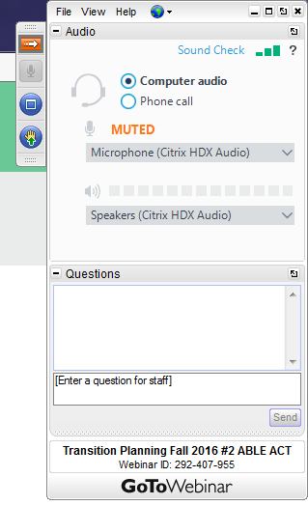
GoToWebinar Procedures
TO USE YOUR COMPUTER'S AUDIO:
When the webinar begins, you will be connected to audio using your computer's microphone and speakers (VoIP). A headset is recommended.
--OR--
TO USE YOUR TELEPHONE:
If you prefer to use your phone, you must select "Use Telephone" after joining the webinar and call in using the numbers below.
United States: +1 (415) 655-0060
Access Code: 725-655-250
Audio PIN: Shown after joining the webinar

Slide 5
ABLE Webinar Attachments
These should have been sent to you after you signed up for the webinar.*
#1 ABLE Power Point
#2 ABLE Act Mini Action Plan
#3 Life After High School Flyer
#4 CaABLE Fact Sheet
* If you did not receive them...they will be available on the RCOC Website.
http://www.rcocdd.com/frc/transition-planning/

Slide 6
Questions
#1 Write in the question box through out the webinar
(These questions may be answered during the presentation or saved for the Q& A session after the presentation.
#2 After the presentation we will take questions from the audience
You may raise your computer hand and the presenters will call on you.
#3 If we run out of time or we don’t have an answer for you, we will develop a Q & A document that will be placed on the RCOC Website.

Slide 7

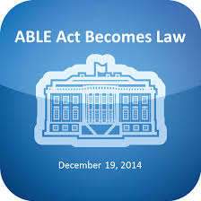
Achieving a Better Life Experience
(ABLE) Act
Division B of Public Law 113-295
December 19, 2014

Slide 8
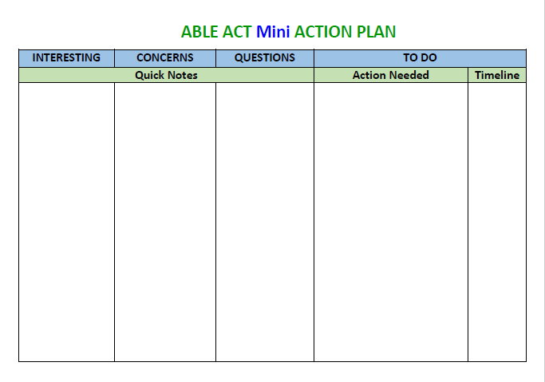

Slide 9
ABLE ACCOUNTS
ABLE Accounts, which are tax-advantaged savings accounts for individuals with disabilities and their families, have been created as a result of the passage of the Stephen Beck Jr., Achieving a Better Life Experience Act of 2014 or better known as the ABLE Act. The beneficiary of the account is the account owner, and income earned by the accounts will not be taxed. Contributions to the account made by any person (the account beneficiary, family and friends) will be made using post-taxed dollars and will not be tax deductible, although some states may allow for state income tax deductions for contribution made to an ABLE account.

Slide 10
The Need For ABLE Accounts...
Meeting Means & Resource Tests
Millions of individuals with disabilities and their families depend on a wide variety of public benefits for income, health care and food and housing assistance. Eligibility for these public benefits (SSI, SNAP, Medicaid) require meeting a means or resource test that limits eligibility to individuals to report more than $2,000 in cash savings, retirement funds and other items of significant value.

Slide 11
The Need For ABLE Accounts continued ... Extra & Significant Costs
To remain eligible for these public benefits, an individual must remain poor. For the first time in public policy, the ABLE Act recognizes the extra and significant costs of living with a disability. These include costs, related to raising a child with significant disabilities or a working age adult with disabilities, for accessible housing and transportation, personal assistance services, assistive technology and health care not covered by insurance, Medicaid or Medicare.

Slide 12
The bottom line...
An ABLE account means that if you get a job, you can save up money without losing your benefits. It also lets family and friends give you money without affecting your benefits.

Slide 13
ABLE Basics
You must meet certain eligibility criteria to open an ABLE account and a beneficiary may only have one ABLE account at any given time.
The “designated beneficiary” is always the account owner (although another person such as a parent or guardian may be allowed signature authority over the account).

Slide 14
ABLE Basics...continued
Funds in the ABLE account will not be taken into consideration when determining eligibility for federally funded benefits, such as Social Security and Medicaid (with one exception related to SSI if/when the account exceeds $100,000)
Contribution to an ABLE account are made with post-tax dollars and funds in the account are to be used exclusively for “disability related expenses”.

Slide 15
Are You Eligible?
To be eligible to open an ABLE account, individuals must meet two requirements:
  Age requirement: must be disabled before age 26
  Severity of disability:
    Have been determined to meet the disability requirements for Supplemental Security Income (SSI) or Social Security disability benefits (Title XVI or Title II of the Social Security Act) and are receiving those benefits,
      OR
    Submit a “disability certification” assuring that the individual holds documentation of a physician’s diagnosis and signature, and confirming that the individual meets the functional disability criteria in the ABLE Act (related to the severity of disability described in Title XVI or Title II of the Social Security Act)*.

Slide 16
ABLE Pays for a Variety of Expenses
Transportation
Employment Training & Support
Personal Support Services
Housing
Assistive Technology
Education & Training
Community Based Supports
Health Care, Prevention & Wellness and Dental Support
Financial Management
Administrative services & other expenses which help improve health, independence & quality of life.

Slide 17
Limits for ABLE Accounts
$14,000 /year
When ABLE Accounts exceed $100,000 the beneficiary’s SSI cash benefit will be suspended until the account falls back under $100,000.
During this suspension time frame, Medi-Cal stays in place
“Medicaid Pay-Back” provision, upon the death of the account owner...the state could recoup Medicaid/Medi-Cal related expenses from the time the account was opened.

Slide 18

The ABLE National Resource Center (ANRC) launched its website on March 1, 2016. The ABLE National Resource Center (ANRC) is a collaborative whose supporters share the goal of accelerating the design and availability of ABLE accounts for the benefit of individuals with disabilities and their families.
We bring together the investment, support and resources of the country’s largest and most influential national disability organizations. www.ablenrc.org

Slide 19

ABLE Act Resource Center
State-by-state ABLE development statuses;
Side-by-side comparisons of ABLE program characteristics;
Informational ABLE videos;
Archived ABLE webinars;
Published ABLE-related research;
Summaries of ABLE-related policies, rules and regulations;
Frequently asked questions (FAQs);
An online portal to submit ABLE-related questions; and
ABLE announcements.

Slide 20

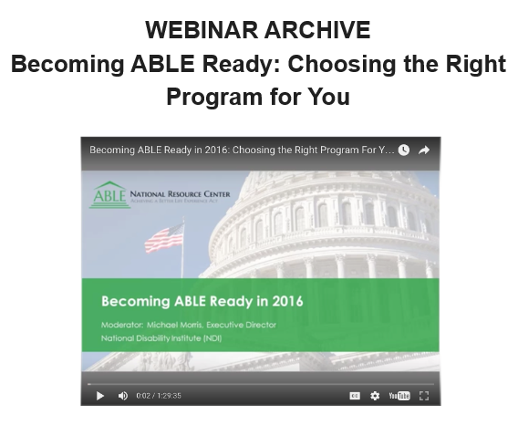
5-26-16
https://www.youtube.com/watch?v=4hmjPR7rxV8

Slide 21
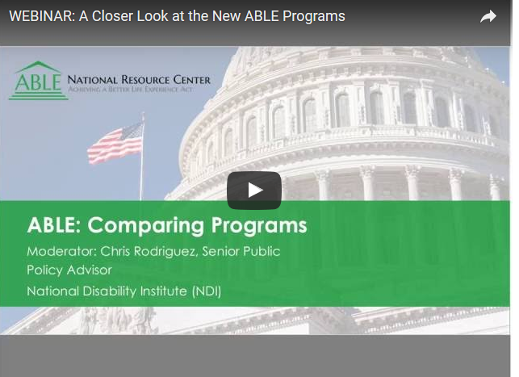
8-4-16
http://ablenrc.org/events/closer-look-new-able-programs

Slide 22
Examples of Short and Long Term Needs/Supports
Some examples may include:
  Long-term supports like personal assistance services which a government funded benefit may cover, but restricts the number of hours per week or month;
  Renovations to where you live to be more accessible;
  Assistive technology like hearing aids or repairs to a wheelchair;
  The purchase of a computer or iPad;
  Supported or customized employment assistance including on-the-job training;
  Public benefits planning; and
  The purchase and retrofitting or modifying of a van.
Investigate costs to meet identified needs and develop a short-term (up to three years) and longer term budget. This can help guide and motivate your ABLE savings.

Slide 23
Maintaining and Utilizing the Account
You may want to consider the following questions:
Is there a required minimum contribution to your account? If so, what is the amount?
Are there annual maintenance fees (set and/or balance-based)?
Are the fees front end loaded or are they reduced if you leave your funds invested for several years?
Are there restrictions or fees associated with how often you can withdraw funds from your account?
Can you access the funds as soon as the ABLE account is opened?
Is there a “debit card/purchasing card” available with the program? Are there added costs to the use of the card?

Slide 24
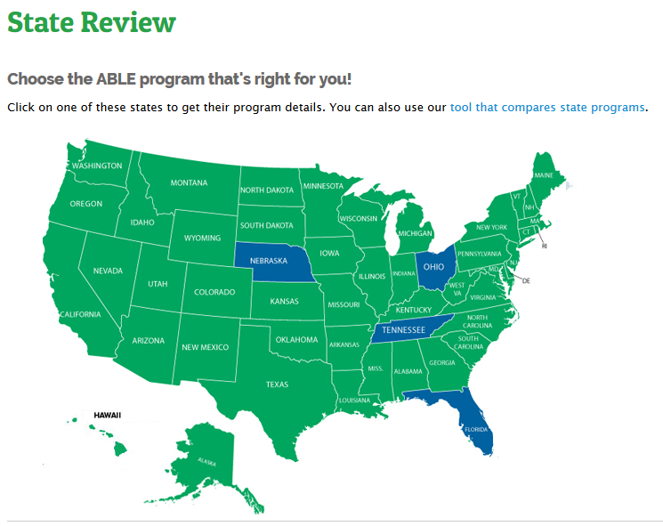
First States to Launch ABLE Accounts
OHIO 6-1-16 STABLE
TENNESSEE 6-14-16 ABLE TN
NEBRASKA 6-30-16 Enable
FLORIDA* 7-1-16 ABLE United
* In-state only

Slide 25
Ohio Launches First ABLE Program in U.S.
“The Stable Account”
The Ohio program focuses on efforts to ensure minimal costs associated with maintaining a STABLE Account. Ohio residents will pay $2.50 per month ($30 annually) to maintain their accounts. Residents of other states will pay $5.00 per month ($60 annually) to maintain their accounts. Ohio residents will also have a small asset-based fee of between 0.19 percent and 0.34 percent, depending on their chosen Investment Options. Similarly, non-Ohio residents will have an asset-based fee of between 0.45 percent and 0.60 percent, depending on their chosen Investment Options.
www.stableaccount.com

Slide 26
Questions to Ask if Considering Opening an ABLE Account in Another State?
How easy is it to put money in the account and take money out for qualifying expenses? For example, does it come with a debit card?
How good is customer support? Try calling the program to see whether it seems helpful.
What investments does it offer? Each state program offers different investment options. Choose a program that offers investments matching your needs.
What fees does the program charge? There may be fees for opening the account and for keeping money in it.
Does the program offer any extra benefits for people living in your state? For example, some state programs offer extra tax benefits for residents of that state.

Slide 27
Vermont Able Task Force
State Comparison Matrix
9-23-16

Slide 28
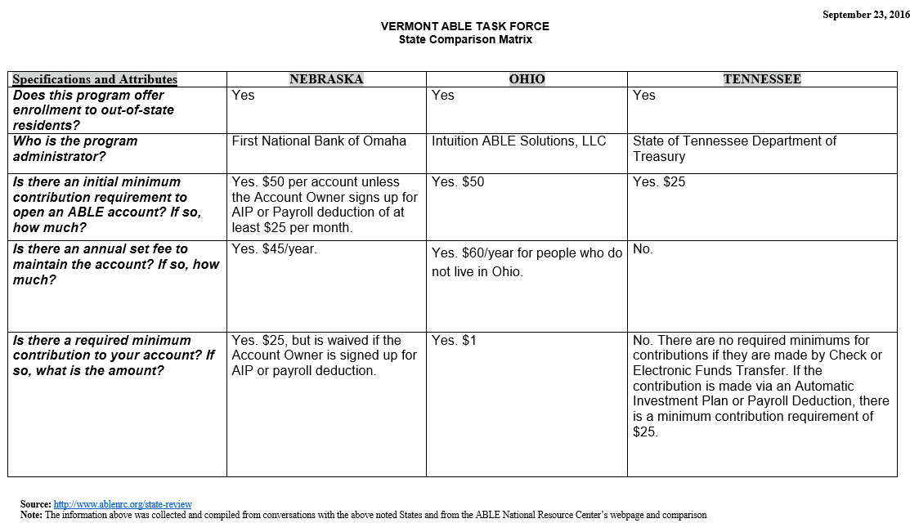

Slide 29
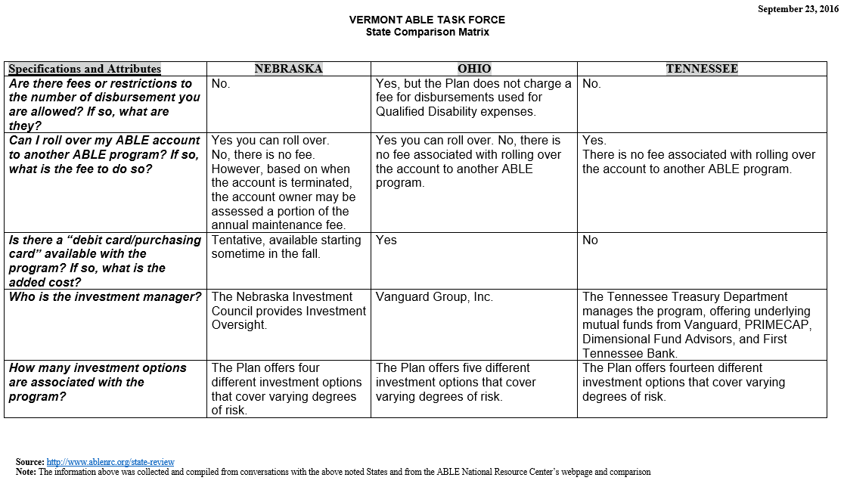

Slide 30
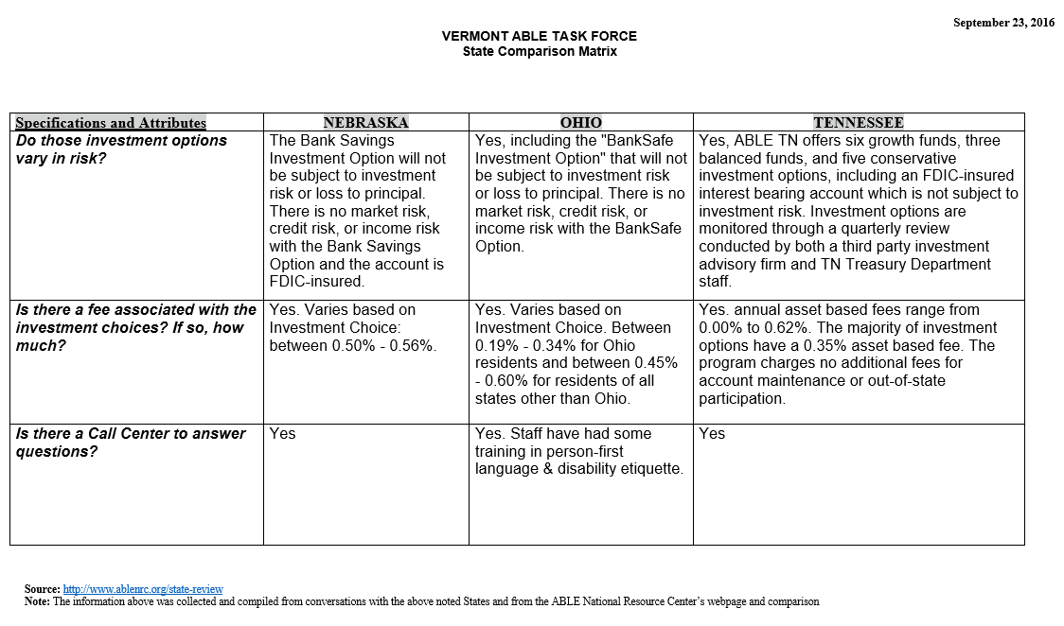

Slide 31
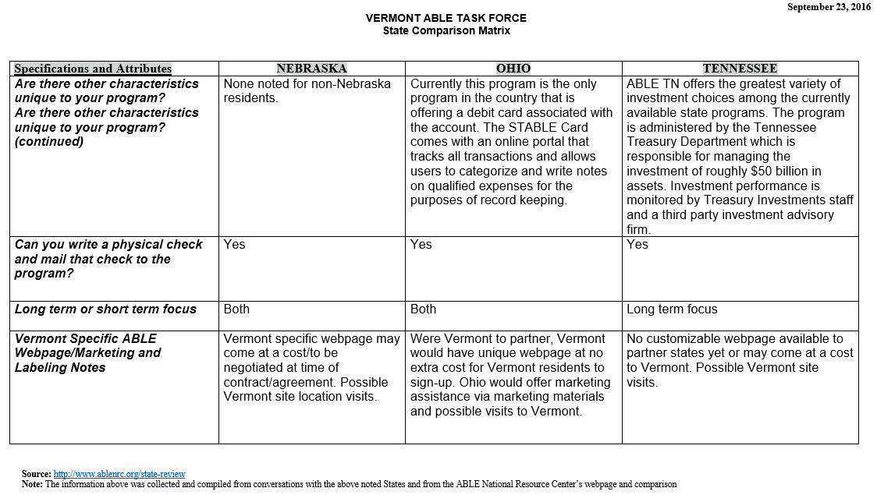

Slide 32

For Further ABLE Related Questions Contact
Chris Rodriguez
Senior Public Policy Advisor
National Disability Institute
crodriguez@ndi-inc.org
www.ablenrc.org

Slide 33
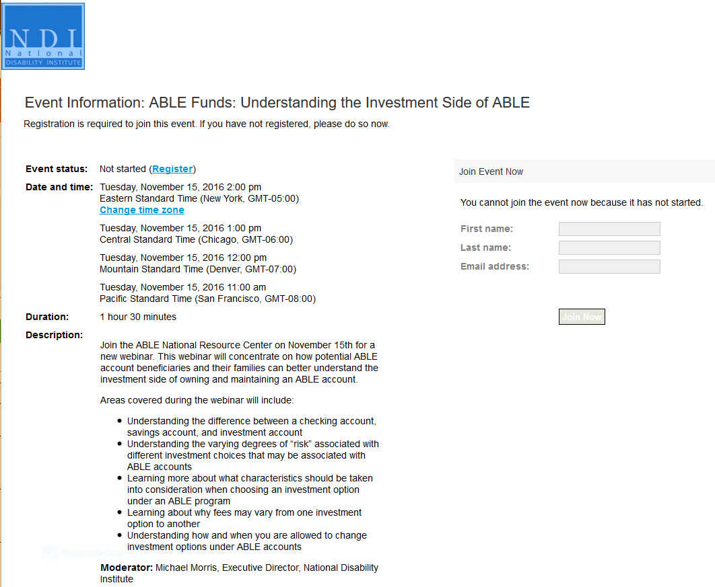
WEBINAR: ABLE Funds: Understanding the Investment Side of ABLE
Tuesday, November 15, 2016 - 11:00 - 12:30 PM PST
https://ndiwebinars.webex.com/ndiwebinars/onstage/g.php?MTID=ee1881959a382b48ffa99328bb8e349944

Slide 34
Pending Federal Legislation to Amend the ABLE Act *Updated 6-9-16
The ABLE to Work Act (HR 4795/S 2702), would allow ABLE beneficiaries that work and earn income to above the current annual maximum contribution of $14,000 annually; (potentially increasing allowable annual contributions to $25,770, if not participating in employer’s retirement plan, ex: 401k)
The ABLE Financial Planning Act (HR 4794/ S 2703), would allow ABLE beneficiaries to roll over a current college savings 529 account to become a 529 ABLE accounts up to the annual maximum contribution; and
The ABLE Age Adjustment Act (HR 4813/ S 2704), would adjust the required age of onset for establishing an ABLE account to be 46 or younger; the current age limit is 26.

Slide 35
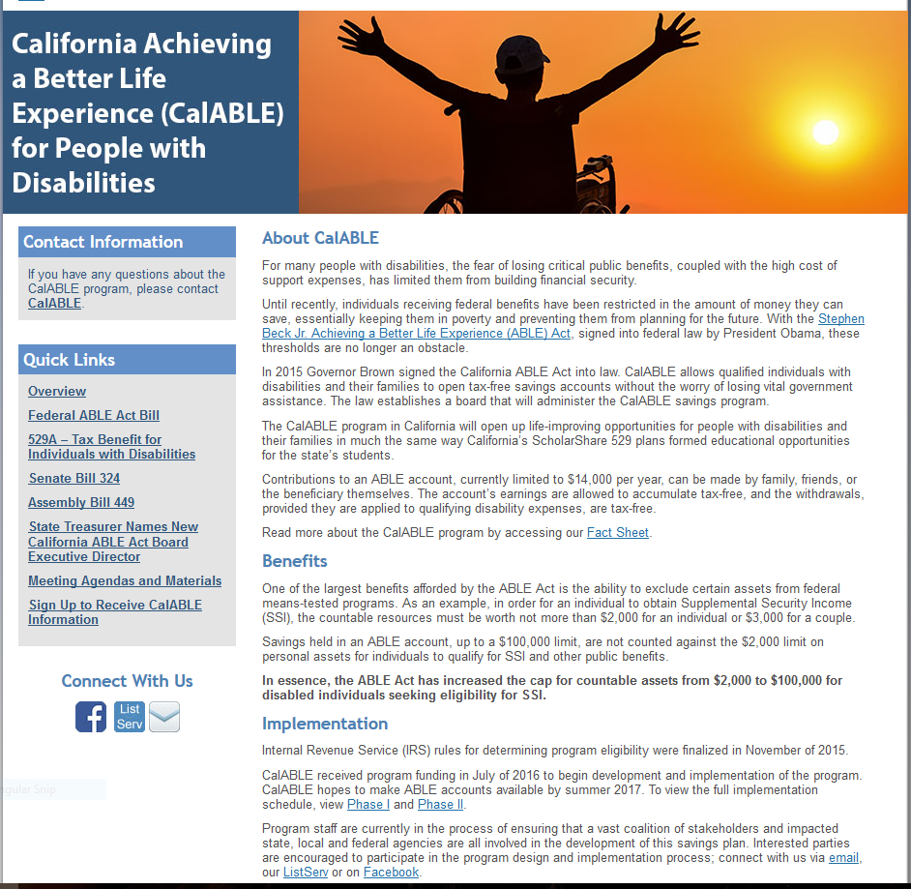
http://www.treasurer.ca.gov/able/
Join the CalABLE
Mailing List

Slide 36
CalABLE
The CalABLE program will open up life-improving opportunities for people with disabilities and their families. Contributions to an ABLE account, currently limited to $14,000 per year, can be made by family, friends, or the beneficiary themselves. The account’s earnings are allowed to accumulate tax-free, and the withdrawals, provided they are applied to qualifying disability expenses, are tax-free. We hope to make ABLE accounts available by summer 2017.

Slide 37
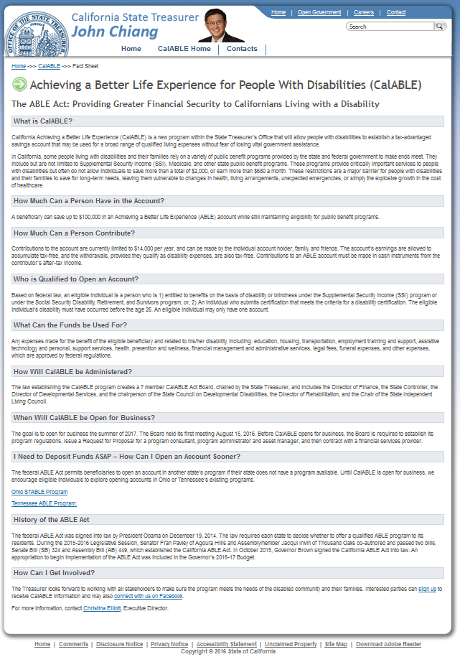

Slide 38
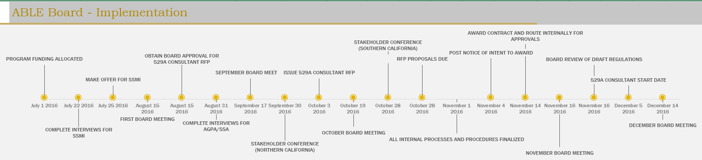

Slide 39
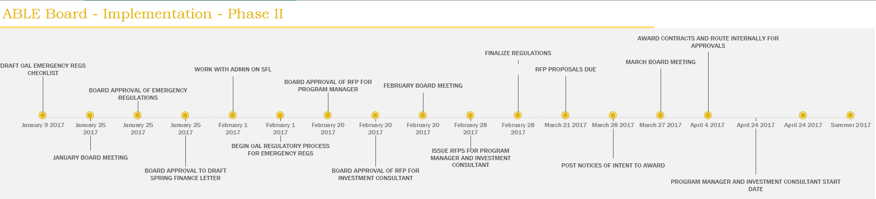

Slide 40
HUD Section 8 Vouchers
Hello,
Your inquiry was forwarded to me. The section of law that governs means-tested programs both
federal and state makes it clear that no federal or state means tested program can count moneys
in an ABLE account as income or earned income. The problem we are facing is HUD has not
updated it’s guidelines to comply with the ABLE Act of 2014 and therefore many residents who have
opened ABLE accounts in different states are encountering trouble if they are asked to confirm
or requalify for eligibility for low income housing.
We are working to build a relationship with HUD executives and ensure they quickly comply, but
state programs administering these federal guidelines have their hands tied at this point.
To answer your question, no, ABLE account funds shall not count as income, but HUD is not complying
so there is a risk some residents might temporarily lose their low income housing because of this. We
do not offer accounts in California yet because of this. We are working to get this smoothed out before
we make accounts available here in our state.
Christina Elliott| MPA
Executive Director|CalABLE Board
CalABLE Website|916.653.4046

Slide 41

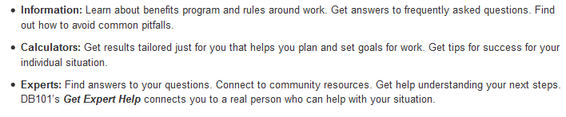
https://ca.db101.org/about.htm

Slide 42
Suggestion...
Keep Current on New ABLE Developments
Because ABLE is a new program...
changes, additions and updates are
being made frequently. Make sure
you have the latest information by:
Routinely checking the Websites
Participating in first run & archived webinars
Getting on the mailing lists
Asking questions
ABLE National Resource Center
www.ablenrc.org
CalABLE Website
http://www.treasurer.ca.gov/able/
Disability Benefits 101
https://ca.db101.org/about.htm

Slide 43


Slide 44

QUESTIONS

Slide 45
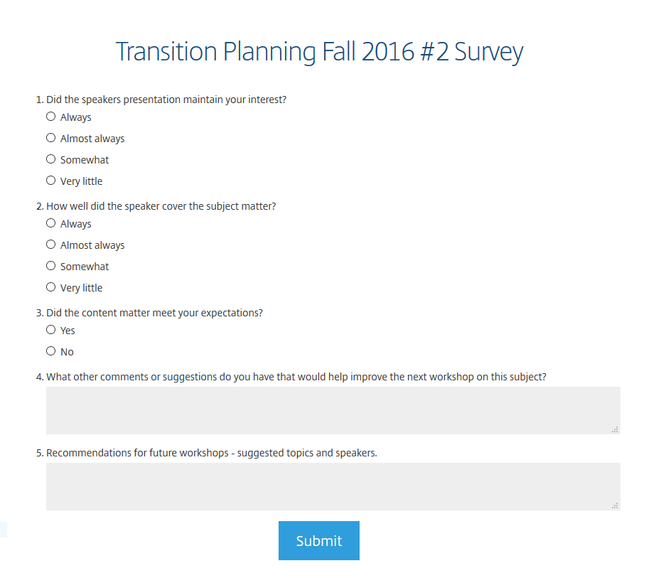
Please take a few minutes to give your feedback on today’s webinar...

Slide 46
Thank You!
Linda ONeal
Janis White
Arturo Cazares

