Slide 1


Presenters
Denise Simpson, M.Ed., Director, Disability Support Services North OC Community
College District, School of Continuing Education
Linda O’Neal, M.A., Consultant, RCOC & SDSU Program Specialist
Janis White, Ed.D., Chief Operating Officer, Regional Center of Orange County
Arturo Cazares, Employment & Day Services Manager, Regional Center of Orange County

Slide 2
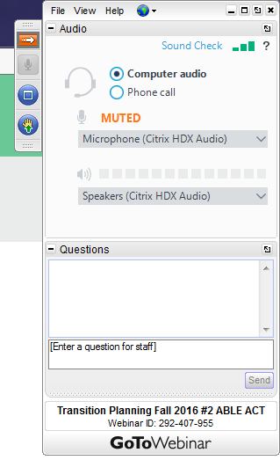
GoToWebinar Procedures
TO USE YOUR COMPUTER'S AUDIO:
When the webinar begins, you will be connected to audio using your computer's microphone and speakers (VoIP). A headset is recommended.
--OR--
TO USE YOUR TELEPHONE:
If you prefer to use your phone, you must select "Use Telephone" after joining the webinar and call in using the numbers below.
United States: +1 (631) 992-3221
Access Code: 898-864-160
Audio PIN: Shown after joining the webinar

Slide 3
Questions
#1 Write in the question box through out the webinar
(These questions may be answered during the presentation or saved for the Q& A session after the presentation.
#2 After the presentation we will take questions from the audience
You may raise your computer hand and the presenters will call on you. If you are calling in, you will need to enter your audio PIN for us to hear you.
#3 If we run out of time or we don’t have an answer for you, we will develop a Q & A document that will be placed on the RCOC Website.

Slide 4
Post Secondary Education
Webinar Attachments
These should have been sent to you after you signed up for the webinar.*
#1 PSE Power Point
#2 Think College Transition Check List
#3 Enhance Access to PSE
#4 PACER’s PSE …What Parents Can Do
#5 OC Community College Contact Information
* If you did not receive them...they will be available on the RCOC Website.
http://www.rcocdd.com/frc/transition-planning/

Slide 5

Transition Planning

Slide 6
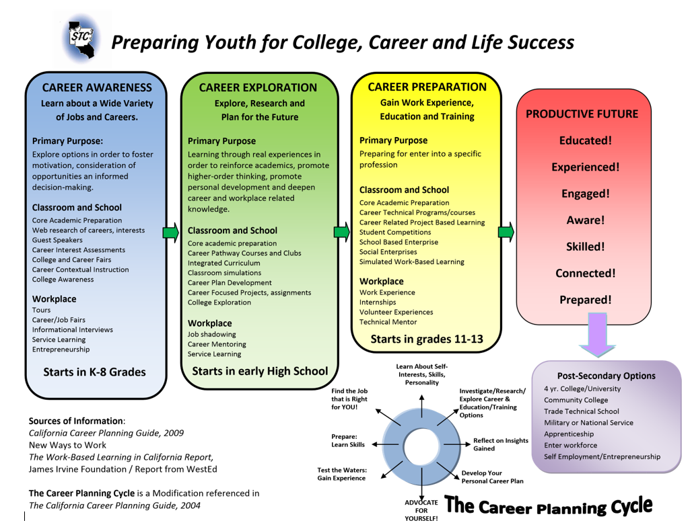

Slide 7

EDUCATIONAL EQUITY

Slide 8
Post Secondary Education & Training
Universities (Private & Public)
Community Colleges
University/Community College Programs for individuals with Intellectual Disabilities
City offered Community Classes for personal interests
Regional Occupational Programs
One Stop Centers/American Job Centers/Workforce Innovation & Opportunity Act Program
Adult Education Block Grant Programs (AEBG)
Private Technical /Trade Schools

Slide 9
Higher Education Opportunities Act 2008
The Higher Education Opportunity Act ( HEOA) (PL 110-315) was enacted on August 14, 2008, reauthorizing the Higher Education Act (HEA) of 1965. This law contains a number of important new provisions that improve access to postsecondary education for students with intellectual disabilities.
The Higher Education Opportunity Act of 2008 Unbolts Doors for Students with Intellectual Disabilities

Slide 10
Higher Education Opportunity Act (HEOA) Provisions
Students with ID access work-study jobs, Pell Grants and Supplemental Educational Opportunity Grants
Authorizes inclusive model comprehensive transition and post-secondary education programs
Authorizes coordinating center
Notes:
10
10

Slide 11
Financial Aid
FAFSA
Board of Governors Fee Waiver
Federal Grants & Loans
Stafford Loans
Plus Loans
Cal Grants
Federal Pell Grants
Campus Based Programs
www.fafsa.com

Slide 12
CA PSE Programs for Students with Intellectual Disabilities (ID)
TAFT College, Bakersfield*
UCLA Tarjan Center, Pathway Program, Los Angeles*
  California State University, Fresno*
  Fresno City College
  Miramar College, San Diego
  Solano College, Solano
  *Campus housing available.

Slide 13
CA PSE/Training Programs for Students with ID (continued)
Foothill College, Los Altos
Reedley College, Reedley*
College of Adaptive Arts, San Jose
Los Angeles Valley College, Tierra Del Sol, Sunland
Lassen Community College, Susanville

Slide 14
California C2C Programs for Students with Intellectual Disabilities
  North Orange County Community College District
  San Diego Community College District
  College of Alameda
  Sacramento City College
  Santa Rosa Junior College
  West Los Angeles College
  Shasta College
  Fresno City College

Slide 15
College Programs for Individuals with ID in Orange County
North OC Community College, C2C
Coastline Community College, ID
Life College/Irvine Valley College, Irvine
Adult Education Block Grant Programs
  Coastline Community College Consortium
  North OC Community College Consortium
  South OC Community College Consortium
  Rancho Santiago Community College Consortium

Slide 16

Bridging the Gap to Independence
Work and
Independent Living
Options for Students with Disabilities
Denise Simpson, M. Ed.
DSS Director

Slide 17
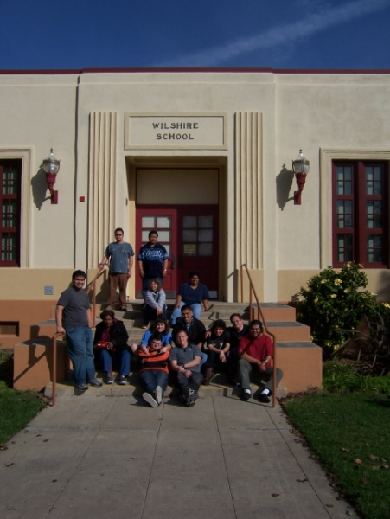
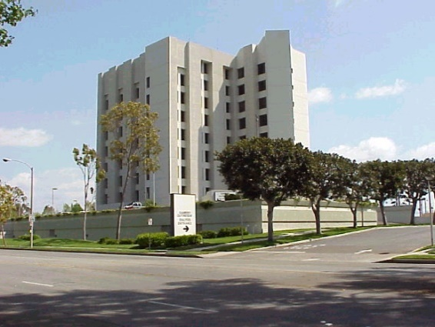


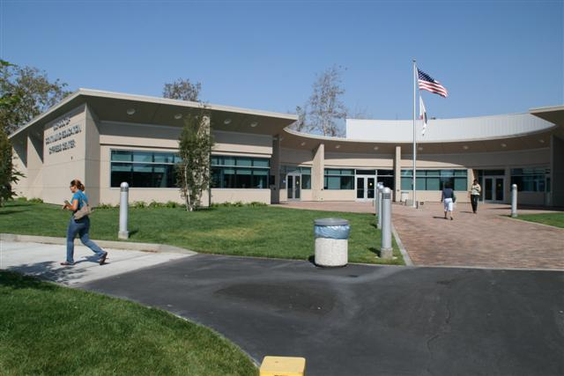
North Orange County Community College District
School of Continuing Education
Anaheim Campus
Adam Gottdank, Counselor
Casey Sousa, ASD Counselor
Michelle Patrick, Counselor
Kim Thompson, C2C Counselor
Wilshire Campus next to Fullerton College
Rosie Navarro, Counselor
Cypress Campus
Kristina de la Cerda, Counselor

Slide 18
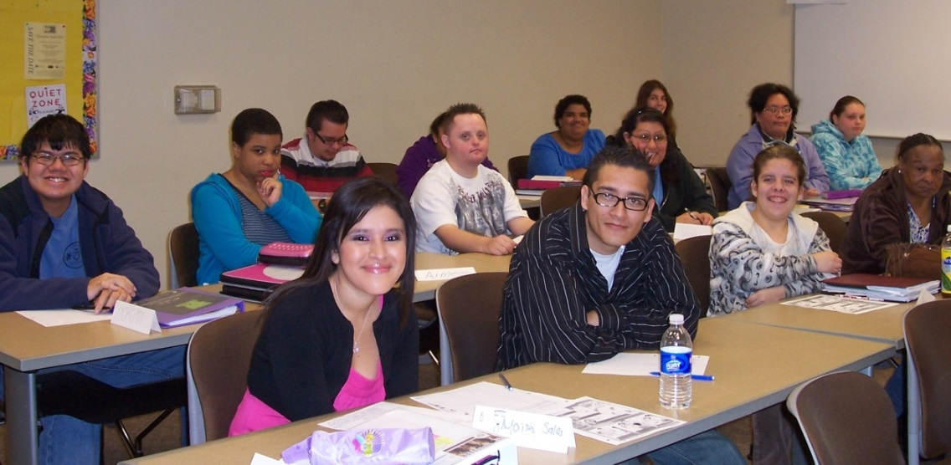
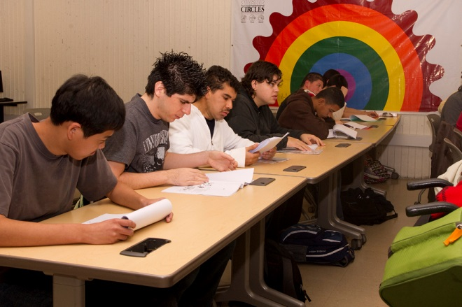
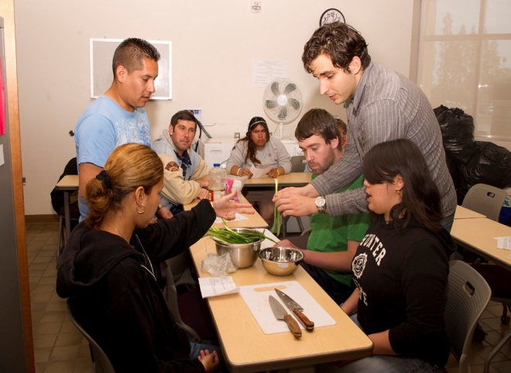
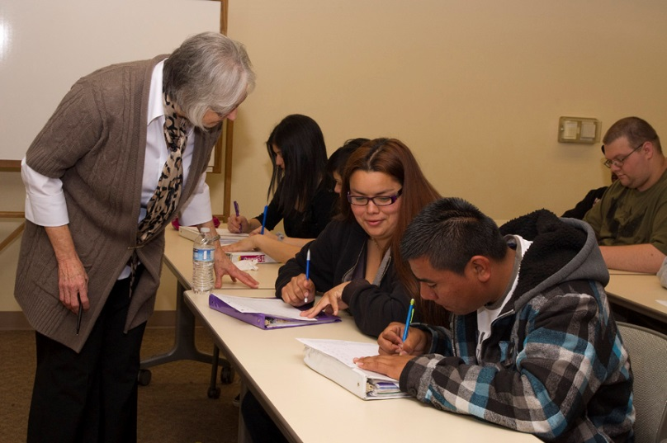
3 main campuses
4 community sites
800 students in classes
475 receive services
Notes:
total 1272

Slide 19
Join together to empower students!
Student
Parent/Support
+ SCE/DSS
SUCCESS
Research indicates that due to the nature of their disabilities, students with intellectual disabilities will be most successful with natural supports, which can include but not be limited to parents, family members and friends (Zhang, Wehmeyer & Chen, 2005).

Slide 20
Short Term ~ Long Term Goals
Think about where you see your son/daughter in 3 years, 5 years, 10 years and 20 years?
Where will they live?
What kind of work will they do?
Who will they spend their free time with?
What do they need to learn to achieve these goals? Talk with your loved one to make sure your goals align with their goals.

Slide 21
We create and deliver all classes to prepare students to work and live more independently.
Goal: To help students prepare for their next step.

Slide 22
Interpersonal Skills Track
Relationships
Sexuality
DSS CLASSES
Life Skills Track
Living More Independently
Basic Cooking
Personal Finance
CORE CLASSES
Social Skills
Self-Advocacy
Academic Track
Reading Skills
Consumer Skills
Computer Track
Basic Computers
Intermediate Computers
Basic MS Office
Basic Photoshop
Employment Track
Occupational Skills
Communication on the Job
Workplace Skills Training
Community Resources

Slide 23
Interpersonal Skills Track
Relationships
DSPS 470 Relationships: Foundation Basics
DSPS 472 Relationships: Build and Maintain Healthy Relations
DSPS 474 Relationships: Relationships Review, Intimacy, and Sexuality Concepts
Sexuality
DSPS 480 Human Sexuality: Human Development, Puberty, and Concepts
DSPS 482 Human Sexuality: Sexual Expression, Reproducing, and Birth Control
DSPS 484 Human Sexuality: Children, Personal Safety, and Healthy Relationships

Slide 24
Life Skills Track
Living More Independently
DSPS 330 Options for Independent Living
DSPS 332 Apartment Living
DSPS 334 Health, Safety, and Living with your Roommate
Basic Cooking
DSPS 450 Beginning Skills
DSPS 452 Intermediate Skills
DSPS 454 More Advanced Skills
Personal Finance
DSPS 260 Introduction to Checking Accounts
DSPS 275 Paying Bills
DSPS 285 Budgeting for Apartment Living

Slide 25
Academic Track
Reading Skills
DSPS 380 Survival Vocab and Basic Read and Writing
DSPS 382 Basic Read Comp and Writing
DSPS 384 Using Read in Real Life Situations
Consumer Skills
DSPS 430 Beginning Money
DSPS 432 Smart Shop and Saving Money in the Community
DSPS 434 Safe Shop and Safe Money Management in the Community

Slide 26
Computer Track
Basic Computers
DSPS 410 Intro to Computers
DSPS 412 Intro to Basic Word Processing
DSPS 414 Intro to Basic Word Processing: Editing
Intermediate Computers
DSPS 420 Intermediate Word Processing
DSPS 422 Intermediate Electronic Mail
DSPS 424 Intermediate PowerPoint Slide Present and Basic Format
Basic MS Office
DSPS 500 Keyboarding and Basic Word Processing
DSPS 502 Exploring the Internet and Email
DSPS 504 Creating PowerPoint Presentations
Photoshop
DSPS 535 Photoshop: Digital Camera Operation
DSPS 537 Photoshop Elements: Introduction
DSPS 539 Photoshop Elements: Layering and Special Effects

Slide 27
Employment Track
Occupational Skills
DSPS 265 Exploring Occupational Paths
DSPS 270 Work Attitudes and Employer Expectations
DSPS 280 Landing a Job
Communication on the Job
DSPS 490 Effectively Deal with Work-Related Problems
DSPS 492 First Impressions on the Job
DSPS 494 Interview and Professional Communication
Work Skills Training
DSPS 325 Workplace Skills Training
DSPS 327 Workplace Safety and Janitorial Sills
DSPS 329 Workplace Skills Training: the Exceptional Employee

Slide 28

WISE
Work, Independence, Self-Advocacy, Education
Wilshire and Cypress Campuses
Partially-funded by the Regional Center
Vendored Program
25 hours each week
5 year program
Most students are at least 22
Transportation (family & Regional Center)
NOCCCD Code of Conduct
Students tend to all personal needs

Slide 29

U.S. Civics Certificate
· U.S. Civics
· U.S. Geography
· U.S. National Symbols and History
Employability Certificate
· Exploring Employment Options
· Prevocational Skills
· Social Skills on the Job
Consumer Skills Certificate
· Money Skills
· Consumer Skills
· Budgeting Skills
Health and Safety Certificate
· Health Skills
· Safety Skills
· Nutrition
Practical Living Certificate
· Kitchen Skills
· Practical Living Skills
· Accessing Community Resources
Regional Center Collaboration
-5 year program
-5 hours per day
-5 days per week

Slide 30
Counseling Appointments
Student driven
Establish Educational, Vocational and Personal goals
DSS class students
  Intake
  Annual Review May 15 – June 30 (Register for new classes for Summer and next year)
SCE class students
  Intake
  Quarterly meeting to renew accommodations
Families are welcome, but not required.

Slide 31
Typical Services Approved by DSS
Counseling
Sign Language Interpreters
Notetakers
Assistive Technology
  Adaptive Equipment
  Kurzweil
  JAWS
  Word Prediction Software
  Ubi-Duo
  Recorders
LD Assessment
Testing Accommodations
Materials in Alternate Format

Slide 32
High School/Learning Center
    HS Diploma (self-paced lab)
    GED Preparation
    Basic Skills Enhancement
English as a Second Language
    Language Acquisition
    Citizenship
Career Technical Education
    Administrative Assistant
    Bartending
    Early Childhood Education
    Pharmacy Technician
    Medical Assisting: Front and Back Office
    Medical Insurance Billing
    Medical Device Quality Assurance
    Funeral Service Assistant
    Sewing: Fashion, Fitting, Alterations
    Computers for Healthcare Workers
    Electrical Trainee Certificate Program
The School of Continuing Education offers an array of noncredit courses. Students may earn a certificate or diploma by successfully completing required courses. Students must complete all requirements without modifications to the curriculum.

Slide 33

Regional Center consumer
At least 18 years of age
Have transportation to/from campus or worksite
Able to be unsupervised
Adhere to a mutually agreed upon schedule with Educational/Job Coach
Demonstrate measured progress toward an educational/vocational goal
Maximum 7 hours per week
One to one support

Slide 34
Student Conduct
All NOCCCD students are required to follow the Standards of Student Conduct BP 5500 https://www.nocccd.edu/files/5500bpfinalrevisedbot-2016-10-25_98983.pdf
Includes ALL students, even those with disabilities
Includes students who disrupt the learning environment intentionally or unintentionally
Ensures a safe and comfortable environment for all students to learn and be successful

Slide 35


When students are able to navigate their world independently, new doors are open to them.
To learn more about our Mobility Training Program, email mobility@sce.edu or call our DSS office.
“Traveling the World One Bus at a Time”

Slide 36

At least 18 years of age
Eligible for DOR
Does not need to be a consumer of Regional Center
Travel independently Willing to start right away
Work independently after services fade

Slide 37
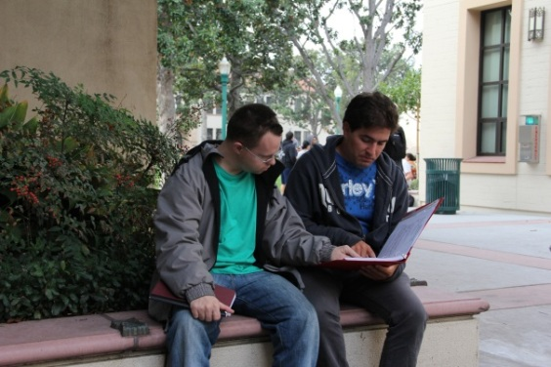
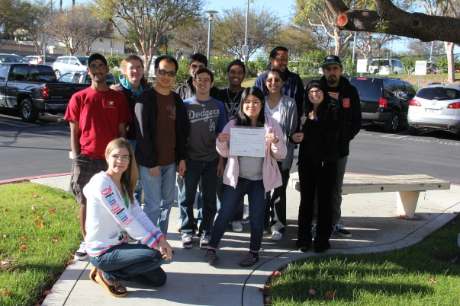
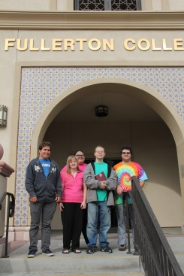

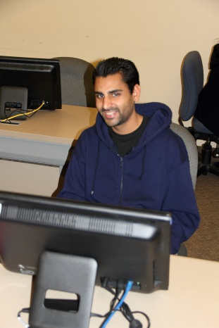
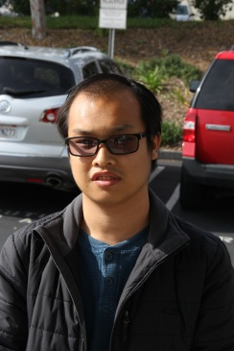
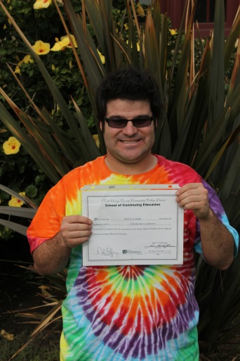

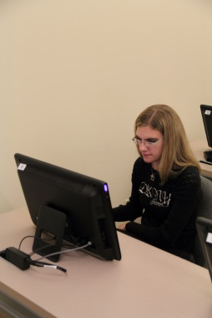
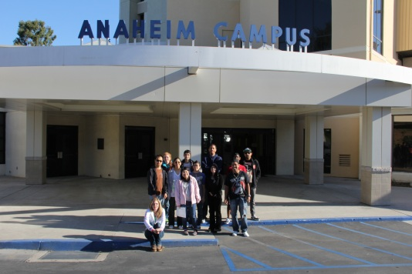
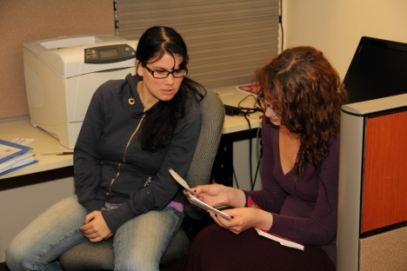
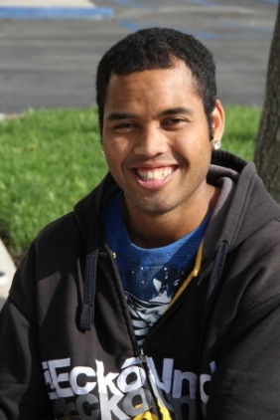
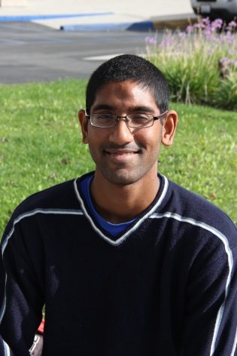
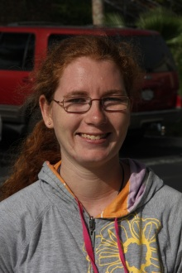
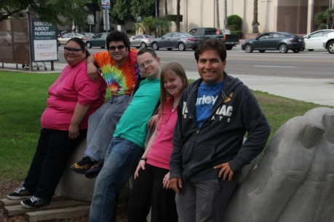
Physical Therapy Assistant Certificate
Administrative
Assistant Certificate
Early Childhood Education Certificate
Automotive
Technology

Slide 38
Annual Transition Night
March 22, 2017
6:00 – 8:00 p.m.
Cypress College Campus
9200 Valley View Street
CC Complex
Cypress, CA 90630

Slide 39
Getting Started
Go to the SCE website at www.sce.edu and apply.
Schedule an appointment with a DSS Counselor by calling 714-484-7057. (You must have a student ID number)
Tour the campus with a counselor, establish goals and then select courses and/or program that will help you attain your goal.

Slide 40



http://aebg.cccco.edu/

Slide 41
AEBG REGIONAL COMPREHENSIVE PLAN WORK GROUPS
WORKGROUP #1
Basic Skills & High School Diploma
WORK GROUP #2
ESL & Citizenship
WORK GROUP #3
Students with Disabilities Programs & Services
WORK GROUP #4
Career Technical Education

Slide 42
ORANGE COUNTY BASIC BLOCK GRANT
North OC Community College District | Coast Community College District | Rancho Santiago Community College District | South OC Community College District
Anaheim UHSD | Coastline Regional Occupation Program | Garden Grove UHSD | Capistrano USD
Fullerton Joint UHSD | Huntington Beach UHSD | Orange County Department of Education | Irvine USD
Garden Grove USD | Newport Mesa USD | Orange Unified School District | Laguna Beach USD
Los Alamitos USD | OC Department of Education | Santa Ana Unified School District | Saddleback Valley USD
North OC Regional Occupation Program |  |  | Tustin USD
OC Department of Education
Placentia Yorba Linda USD

Slide 43
Enhancing Access to PSE
Provide Encouragement & Information
Foster & Promote Student Self-Determination & Independence
Assist with Understand Legal Rights & Responsibilities
Promote Understanding and Arrangement of Needed Academic Accommodations
Shaw, S.F. (2009) Enhance Access to Postsecondary Education for Students with Disabilities.

Slide 44

www.thinkcollege.net

Slide 45

Rethinking College is a 25 minute ﬁlm produced by Think College that explores the growing movement to include students with intellectual disabilities in higher education.
Check out the 4 minute Trailer!
http://www.thinkcollege.net/training/rethinking-college-the-film

Slide 46
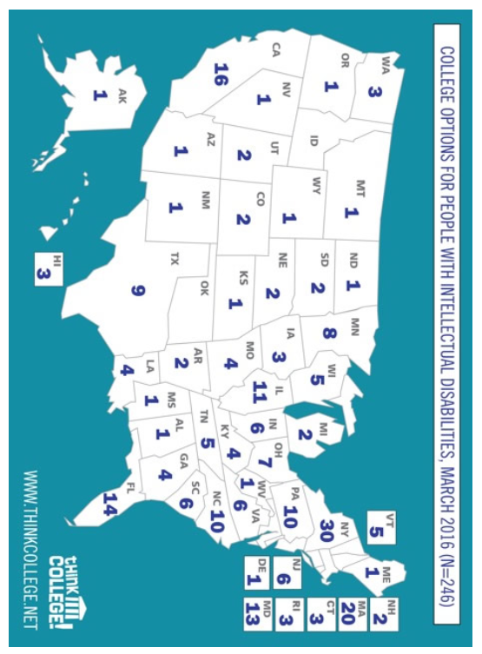

Slide 47
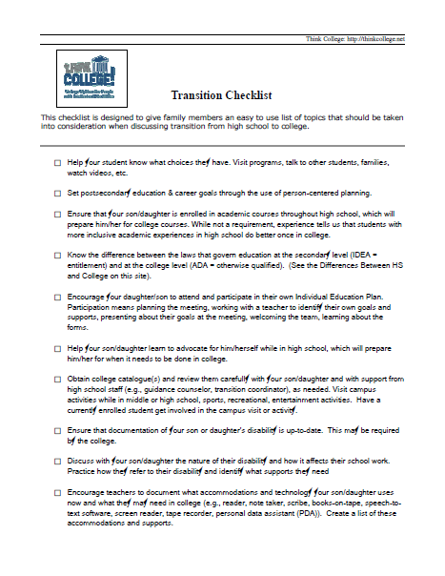

Slide 48
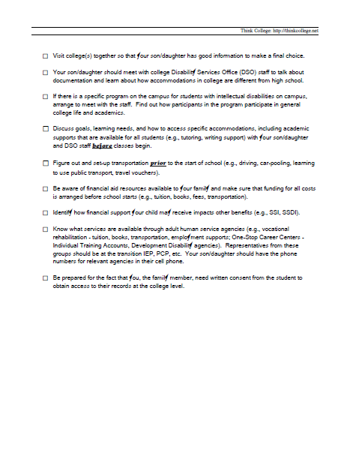

Slide 49
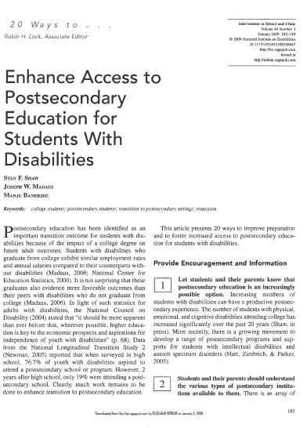
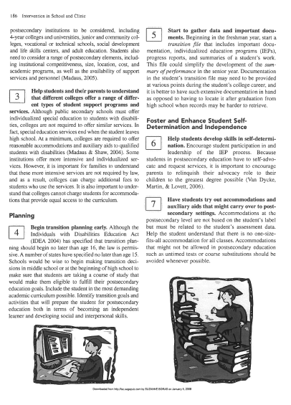

Slide 50
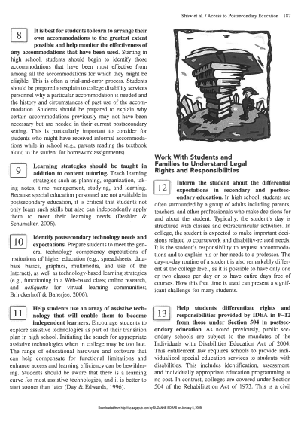
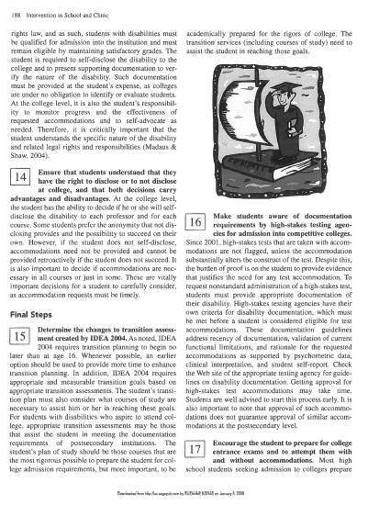

Slide 51
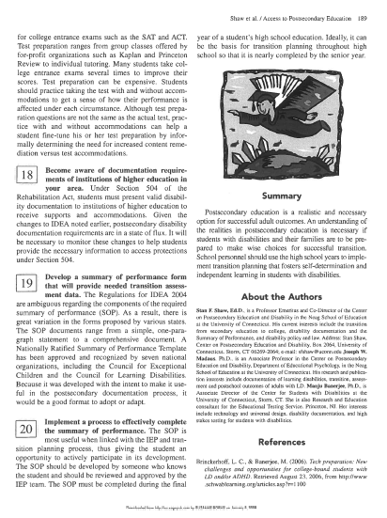
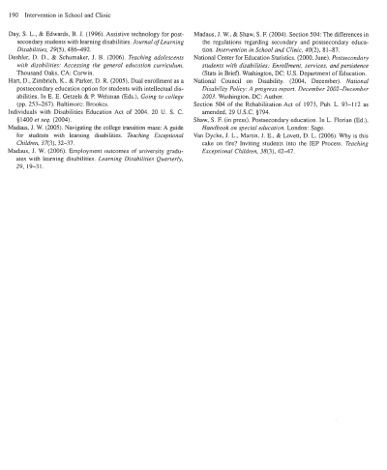

Slide 52
Educational Coach
Purpose:
Assist with inclusion of students in college courses, work, and campus life

Slide 53
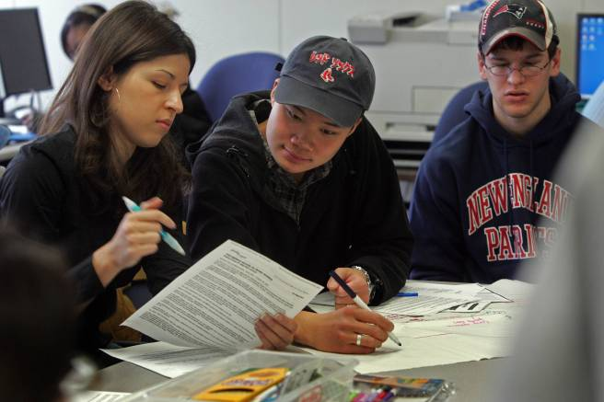
Students helping Students!
Notes:
53

Slide 54
Educational Coach
Responsibilities:
Help maintain positive academic environment
Academic tutor when needed
Assist students with understanding assignments
Maintain student records
Encourage appropriate college behavior
Foster student independence
Help students with time management
Relay communication about student progress
Work as a team member

Slide 55
Educational Coaching
Things to think about:
  Good match between coach & student
  Open communication with HS staff, college personnel, transportation & family
  Understanding philosophy of personal choice, independence & high expectations in all settings
  Risk taking
  Respect that this is challenging, but important work
  Blend and braid resources to find funding
Notes:
55

Slide 56


Transition Workshop Materials
www.rcocdd.com
Quick Links on the Main Page
Transition Planning
Available 2 weeks after presentation

Slide 57


Slide 58
QUESTIONS
Transition Planning
??????

Slide 59

Thank you for your Participation!
Questions?
Contact: Transition@rcocdd.com

