Slide 1


Slide 2
Goals for this evening:
Overview of the Housing Crisis in Orange County
Identify four Housing Authorities
Understand how Regional Center of Orange County can provide support
Know housing options that are in progress
Identify other important housing resources
Obtain tools to advocate for housing in your city

Slide 3
About IHO
IHO enriches communities through high-quality affordable housing, economic self-reliance and other services for those most in need
“It Starts with Housing” reflects IHO’s core belief that through collaboration, creativity, and buy-in from all stakeholders, residents can dream of and achieve endless possibilities

Slide 4
IHO’s Vision
Develop vibrant, sustainable, catalytic communities
Develop individuals and families; Raise up leaders
Create a comprehensive, and replicable new legacy of housing and community development
Make communities accessible to those who may not otherwise have access

Slide 5
OC Renters in Crisis:
Report from California Housing Partnership (2017)
      Cuts in federal and state funding have reduced investment in housing in Orange County by 76% or $117 million annually since 2008
      Renters need to earn more than 3.5 times local minimum wage to afford OC’s median asking rent of $1950
      OC’s lowest income renters pay 87% of income on rent
      OC needs 109,965 more affordable units to meet lowest income needs

Slide 6
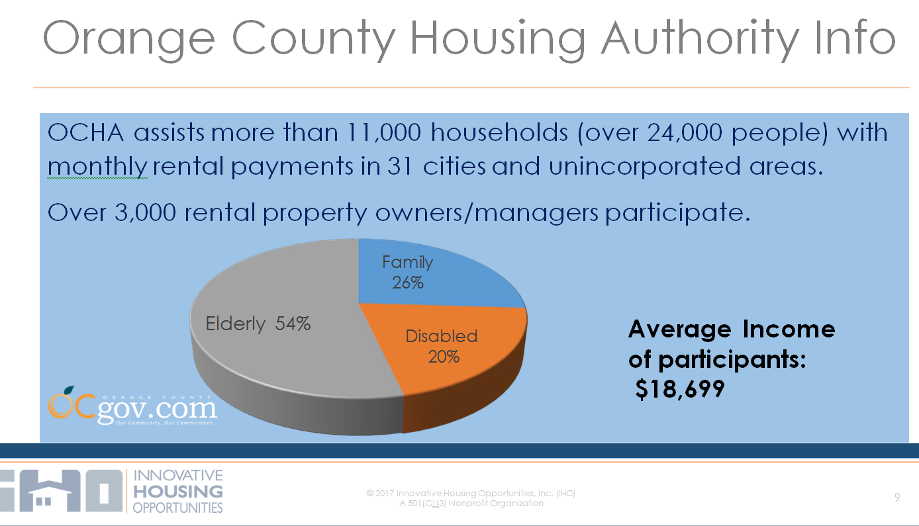

Slide 7

Orange County Housing Authority Information
OCHA is funded from the U.S. Department of Housing and Urban Development (HUD)
Annual HUD funding for Housing Assistance Payments (Voucher Program) is about $117 million
OCHA can only use HAP funds to pay property owners or managers
OCHA has limited ability to use funds from other sources for security deposits for special needs homeless clients

Slide 8
Orange County Housing Authority Information
Housing Choice Voucher Program (HCVP)
About 9,400 households assisted
Turnover = about 45 vouchers per month
Waiting List = over 42,000 applicants (from two weeks in February 2012).
Portability: Assistance for over 1,400 tenants who received a Housing Voucher from another housing agency who moved into OCHA’s participating cities.
Mobility - OCHA partners with Anaheim and Garden Grove housing authorities to enable over 1,800 mobility tenants to reside in OCHA’s jurisdiction

Slide 9
Housing Authority Contacts
County of Orange
OC Community Resources
Marie Vu
Section Chief, Special Housing Prog
(714) 480-2830
John.Hambuch@occr.ocgov.com
Anaheim Housing Authority
Grace Stepter
Housing Programs Manager
(714) 765-4320
GStepter@anaheim.net
City of Garden Grove
Community Development Department
Danny Le Huynh
Housing Manager
(714) 741-5150
DannyH@ci.garden-grove.ca.us
Santa Ana Housing Authority
Judson Brown
Housing Division Manager
(714) 667-2241
JBrown@santa-ana.org

Slide 10
How can the Regional Center of Orange County Help You?
http://issuu.com/regionalcenterofoc/docs/guide_to_living_arrangements_-_adults3613?e=6820093/6334150

Slide 11
What’s Coming in OC’s Pipeline?
      Affordable Rentals Completed in 2017: 397 units
        Andalucia, Santa Ana (56)
        Anton Portola, Irvine (256)
        Oakcrest, Yorba Linda (69)
        Potters Lane, Midway City (16 veterans)
      Under Construction: 775 units
        200 are restricted to seniors
      Projected in Pipeline (2018 or later): 992 units
        232 are restricted to seniors or veterans

Slide 12
OC Pipeline –continued
      According to OC Register, April 14, 2017, 1500 affordable units are currently under development in Santa Ana
In April the city council, earlier this week, unanimously approved 100 federal housing vouchers for two projects:
75 vouchers for Santa Ana Veteran’s Village for homeless veterans
25 for Aqua Housing for chronically homeless individuals

Slide 13
OC Pipeline –continued
      Affordable Rentals under development in Santa Ana
694 units: AMG family and senior apartments
443 units: AMG senior apartments
64 units: AMCAL Housing affordable apartments
58 units: Meta Housing artist colony
54 units: Tiny Tim Plaza affordable housing

Slide 14
What Resources Are Out There?
      HUD Section 811 Supportive Housing for Persons with Disabilities
Projects funded by capital advances and supported by project rental assistance contracts (PRACs)
  50% AMI - at least one adult member with a physical or developmental disability or chronic mental illness
Projects funded with Project Rental Assistance
  30 % AMI - at least one adult member with a disability

Slide 15
Resources
Fair Housing Council of Orange County
Denice Cato
President & CEO
(714) 569-0823
Dcato@FairHousingoc.org
Elder Law & Disability Rights Center
Brooke Weitzman, Esq.
Founder, Attorney
714-617-5353
Bweitzman@eldrcenter.org

Slide 16
Resources –continued
      Achieving a Better Life Experience (ABLE) tax-advantaged accounts for people with disabilities The first $100,000 does not negatively impact the $2,000 Supplemental Security Income (SSI) resource limit, Medi-Cal or CalFresh (formerly Food Stamps)
      Other savings programs: Individual Development Accounts (IDAs), the career development program Plan to Achieve Self-Support (PASS), and Special Needs Trusts

Slide 17
What Can You Do?
                Tell Your Story!
Put a face to our cause
Make it personal
Get organized
Be consistent

Slide 18
Next Steps
Develop a clear, succinct message with no more than 5 goals/demands
Highlight the win-win for all stakeholders
Invest in high quality marketing materials that will have legs of their own: video sound bites, hand outs that reinforce our message and goals
Create a systematic, consistent game plan and follow it

Slide 19
Next Steps –continued
Locally
Meet with City Councils to discuss Housing Elements, By-right and Inclusionary Housing opportunities
Enlist Housing Authorities and other stakeholder groups to meet with Landlord Associations to present the benefit of accepting vouchers
Work with Kennedy Commission to advocate for extremely low-income households in local hearings (kennedycommission.org)

Slide 20
Next Steps –continued
State and Federal
Weigh in on proposed updates to Housing Element Law to incorporate enforcement (local and state level)
Make the case for inclusion of DD population in housing set asides for age, race, disability, homelessness
Work with lobbyist to update HUD’s special class definitions
Update the Section 811 so it is advantageous to develop housing under it

Slide 21
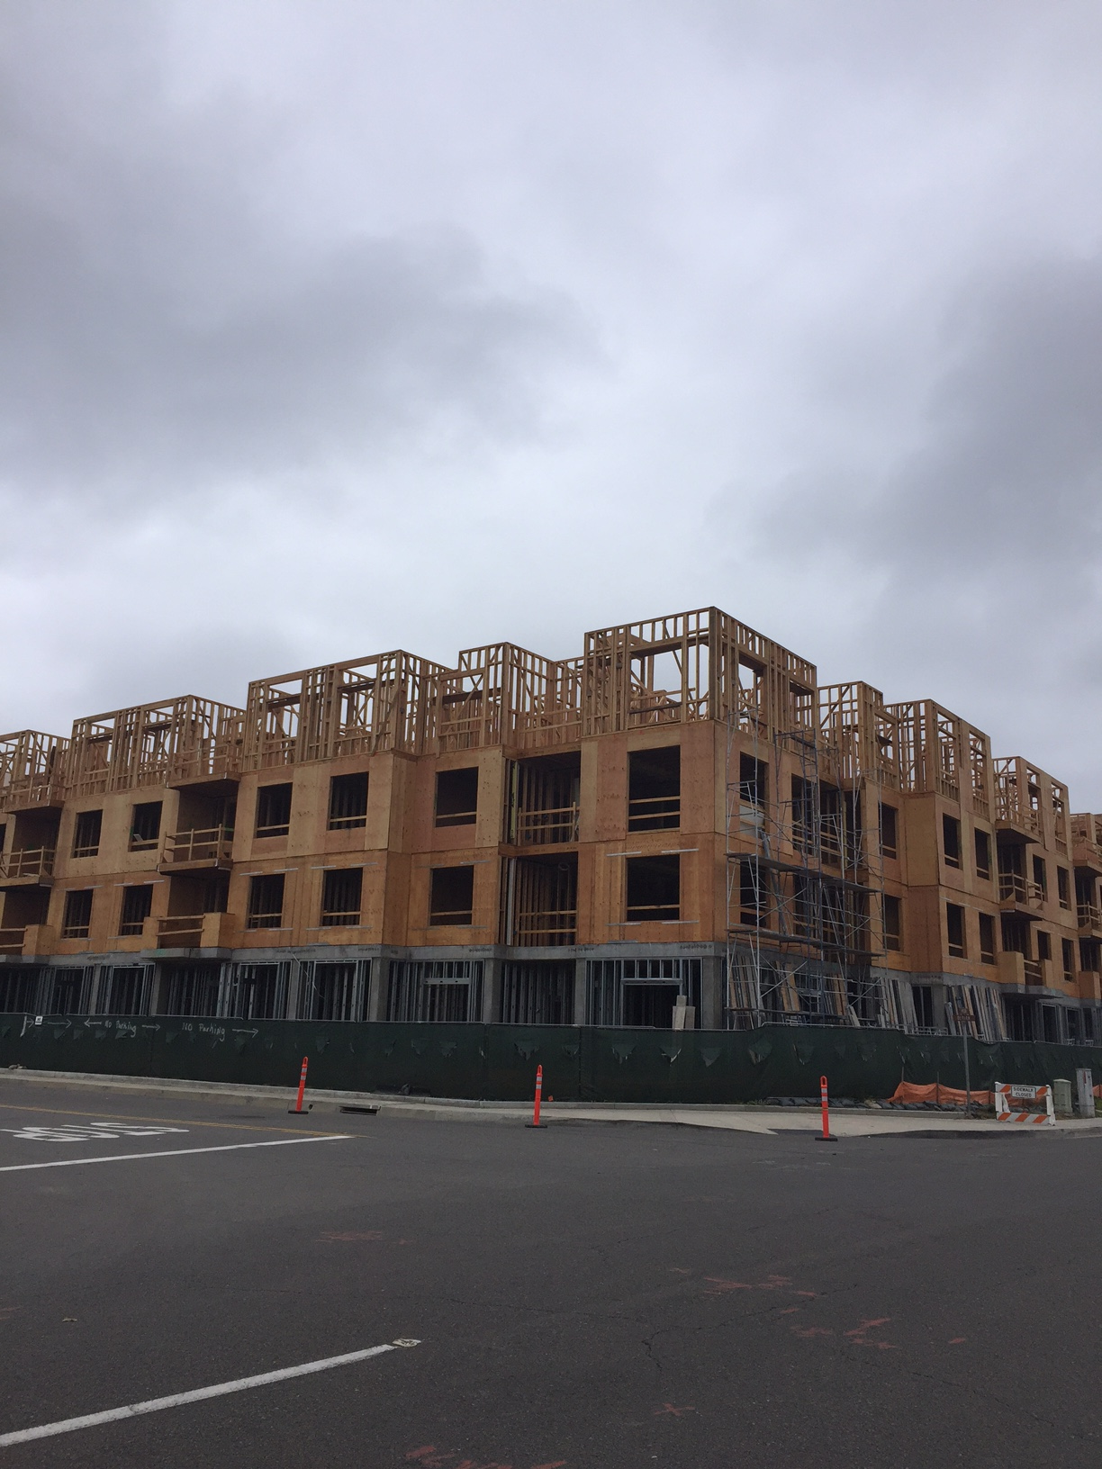
Parc Derian Apartments, Irvine
      9% LIHTC ($18.4M)
      City of Irvine ($1.5M)
      City of Irvine HOME (HUD) ($.6M)
      City of Irvine Fee Reduction ($.4)
      Irvine Land Lease
Total Development Cost $33.6M; $420K per unit
80 units: 63 large families, 8 veterans, 4 formerly homeless, 4 DD (5% of total units)

Slide 22
El Verano Apartments, Anaheim
      9% LIHTC ($3.4M)
      Anaheim ($2.33M)
      AHP ($.5M)
      53 Project Based Vouchers
      Anaheim Land Lease
Total Development Cost $22.8M; $422K per unit
54 units: 53 seniors (% DD TBD)

Slide 23


More Information
Pat Whitaker
President of Development & CEO
pwhitaker@innovativehousing.com
(949) 863-9740 x302
Rochelle Mills
Vice President of Development & Programs
rmills@innovativehousing.com
(949) 863-9740 x304

