Slide 1


Transition Planning
Competitive Integrated Employment
Creating a Life Full of Possibilities
2016-2017 #4
January 12, 2017

Slide 2
Presenters
Linda O’Neal, M.A., Consultant, RCOC & SDSU Program Specialist
Janis White, Ed.D., Chief Operating Officer, Regional Center of Orange County
Arturo Cazares, Employment & Day Services Manager, Regional Center of Orange County

Slide 3
AGENDA
Welcome
Webinar Procedures
Defining Competitive Integrated Employment
National Statistics
OC Pre-Employment Skills Development
Employment Skills Development Chart
CIE Opportunities
Supplemental Security Benefits
SSA Work Incentives
Benefits Planning
Questions
Survey Completion
Education
Recreation
Agencies
Work
Mobility
Home
TRANSITION PLANNING

Slide 4
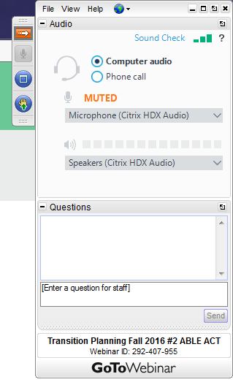
GoToWebinar Procedures
TO USE YOUR COMPUTER'S AUDIO:
When the webinar begins, you will be connected to audio using your computer's microphone and speakers (VoIP). A headset is recommended.
--OR--
TO USE YOUR TELEPHONE:
If you prefer to use your phone, you must select "Use Telephone" after joining the webinar and call in using the numbers below.
United States: +1 (631) 992-3221
Access Code: 898-864-160
Audio PIN: Shown after joining the webinar

Slide 5
Questions
#1 Write in the question box through out the webinar
(These questions may be answered during the presentation or saved for the Q& A session after the presentation.
#2 After the presentation we will take questions from the audience
You may raise your computer hand and the presenters will call on you. If you are calling in, you will need to enter your audio PIN for us to hear you.
#3 If we run out of time or we don’t have an answer for you, we will develop a Q & A document that will be placed on the RCOC Website.

Slide 6
Competitive Integrated Employment
Webinar Attachments
These should have been sent to you after you signed up for the webinar.*
#1 OC Pre-Employment Skills Development Chart
#2 OC Employment Skills Development Chart
(Work-Based Learning Evaluation Chart)
#3 Employment Rating Referral Summary Chart
#4 Fact Sheet: Social Security Administration (SSA) Changes 2017
#5 Partnerships in Employment: Research on Elevating Parent Expectations
#6 Employment Related Resources for Families
* If you did not receive them...they will be available on the RCOC Website.
http://www.rcocdd.com/frc/transition-planning/

Slide 7

Transition Planning

Slide 8
Competitive
Integrated Employment
CIE

Slide 9
National Statistics
Each year more than 7.5 million Americans with disabilities draw more than $73 billion from the Social Security Administration (SSA)
… less than 1% of these individuals ever become self-supporting through employment

Slide 10


Employment First
…The full inclusion of people
with the most significant disabilities
in the workplace and community (with)
community-based, integrated employment as the first option ...
Integrated competitive employment refers to jobs held by people with disabilities in typical workplace settings where the majority of persons employed are not persons with disabilities, they earn at least minimum wage and they are paid directly by the employer.
http://www.dol.gov/odep/topics/EmploymentFirst.htm

Slide 11

Employment Nationally
Department of Justice sued states to close sheltered workshops and segregated day programs:
  Oregon
  Delaware
  Rhode Island
46 states with some type of effort focused on Employment First (up from 26 recently)
  19 States have an official state policy
  32 States with formal policy action
Notes:
Latest RI. national movement in invoking the Olmstead Act to move people out of large institutions. One of the last institutional settings is the sheltered workshop.
A summary of the status of Employment First nationally is as follows:
• Employment First efforts have been identified in 42 states.
• Twenty-six states have been identified that have something akin to an official Employment First policy (based on legislation, policy directive, etc.). Twelve states have passed legislation: California, Delaware,
Illinois, Kansas, Maine, North Dakota, Ohio, Pennsylvania, Texas, Virginia, Utah, and Washington.
The other 14 (Arkansas, Colorado, Connecticut, District of Columbia, Louisiana, Maryland, Massachusetts, Missouri, New Jersey, Oklahoma, Oregon, Rhode Island, Tennessee, Vermont) have a policy directive, Executive Order, or similar official policy statement, but not legislation.
• Eleven of these policies are cross-disability: Arkansas, Delaware, District of Columbia, Illinois, Kansas, Maine, New Jersey, North Dakota, Texas, Virginia, and Utah. The remainder of states with policies, have policies that focus exclusively on individuals with intellectual and developmental disabilities: California, Colorado, Connecticut, Louisiana, Maryland, Massachusetts, Missouri, Ohio, Oklahoma, Oregon, Pennsylvania, Rhode Island, Tennessee, Vermont, Washington.
• In addition to the 26 states with Employment First policies, the other 16 states on this list (Alabama, Florida, Georgia, Idaho, Indiana, Iowa, Kentucky, Michigan, Minnesota, Mississippi, Nevada, New Mexico, New York, North Carolina, South Dakota, Wisconsin) have Employment First efforts and initiatives underway, but at this point it appears no official Employment First policy has been issued. It is important to recognize that the presence or lack of presence on this list of any state should not necessarily be an indicator regarding the state’s focus on employment for people with disabilities. There are a number of states that have not been linked with Employment First, who have consistently had relatively strong outcomes in terms of employment of people with disabilities. However, the emergence of Employment First as a national movement has served as a catalyst for an increased focus on employment of people with disabilities across the United States.
In the course of developing this document, the focus has been on including as many examples as possible, particularly in terms of resources from individual states. The underlying rationale for doing so is to provide an understanding of the wide range of approaches to Employment First. Inclusion of specific policies and documents on this list should in no way be viewed as an endorsement of these documents, and in fact, the Employment First legislation/policies that have been developed vary significantly in terms of the strength and clarity of their language. The wide range of attention and emphasis on Employment First has been encouraging, and provides a potential catalyst for the long needed increase in workforce participation for individuals with disabilities. At the same time, it is important to recognize that creation of documents, reports, and policies, in and of itself, will not result in increases in workforce participation, without a long-term commitment to action steps that make the Employment
First vision a reality for all citizens with disabilities. Setting a vision and direction is a starting point – but it must be done in conjunction with comprehensive systems change that results in shifting of resources towards integrated employment, a service system that provides consistent and high quality employment assistance and supports, and measurement and accountability for achieving employment outcomes. Employment First is also about more than just simply changing how services and supports for people with disabilities are provided – it is a catalyst for and reflective of an ongoing fundamental cultural shift and view by policymakers, public officials, service systems, service providers, employers, and most importantly by individuals with disabilities themselves, that views people with disabilities as full participants in the economic mainstream, working side-by-side with their fellow citizens.

Slide 12
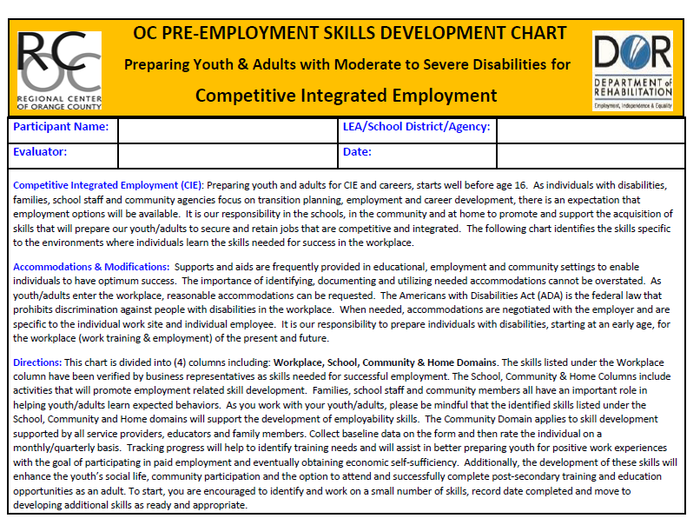

Slide 13
Pre-Employment Skills
Follows Directions
Dress/Hygiene
Time Management
Work Tasks
Productivity/Quality of Work
Communication/Socialization
Utilizing Natural Supports
Mobility/Community Safety/Transportation

Slide 14
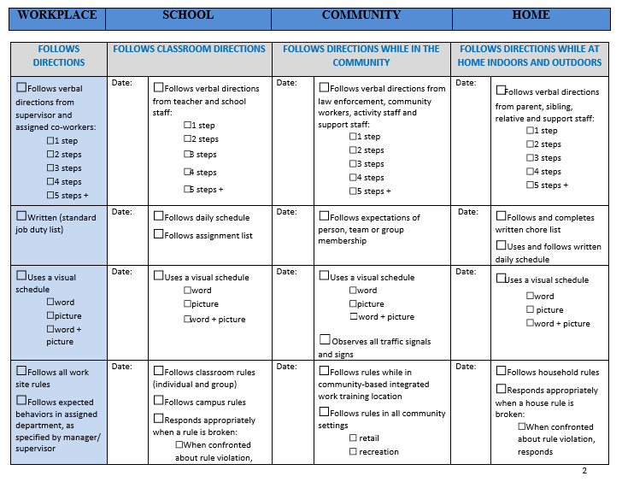

Slide 15



Work-Based Learning: job shadows, volunteering, internships, etc.

Slide 16
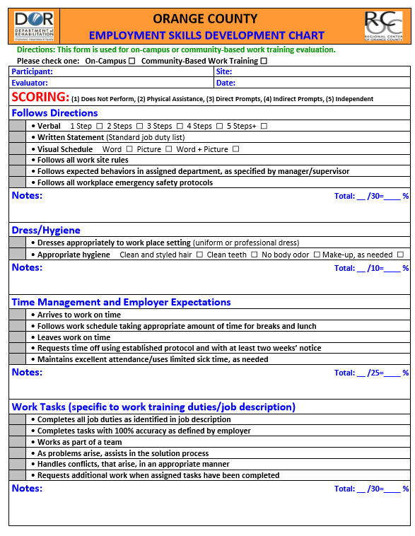
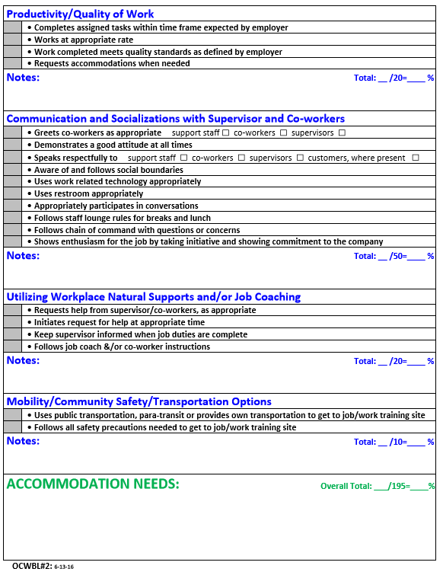

Slide 17
Employment Opportunities:
Competitive and Integrated

Slide 18
Employment Rates for Youth with Disabilities
Employment Rates for Youth with Disabilities
With Disability Without Disability
Age 16 to 19 16.6% 29.9%
Age 20 to 24 31.6% 65%
Source: US Department of Labor, Office of Disability Employment Policy, August 2014

Slide 19
Employment Rates in California
In California 13% of working age adults with intellectual developmental disabilities get a paycheck. Their average earnings are $5,818
a year.
CA Department of Developmental Services, 2013
Notes:
75,450 people with IDD receive day program or employment services from California’s 21 Regional Centers. The vast majority, 72% attend day activity programs, and only 28% receive employment services. Of those receiving employment services…
14% are in segregated non-competitive work activity programs (i.e., sheltered workshops)
8% are in group-supported employment, including enclaves
6% receive individual support services in Integrated Competitive Employment (ICE)
CA Department of Developmental Services, 2013

Slide 20
Employment Related Legislation/Rules/Policies
New rules through Center for Medicare and Medicaid Services (CMS)
Workforce Innovation and Opportunities Act (WIOA) (7/22/14)
RCOC’s Employment First Policy (3/2014)
Notes:
CMS – have the opportunity to receive services in the most integrated setting appropriate

Slide 21
Integrated Employment
“In work in a setting typically found in the community in which individuals interact with individuals without disabilities other than those who are providing services to those individuals, to the same extent that individuals without disabilities in comparable positions interact with other person.”

Slide 22
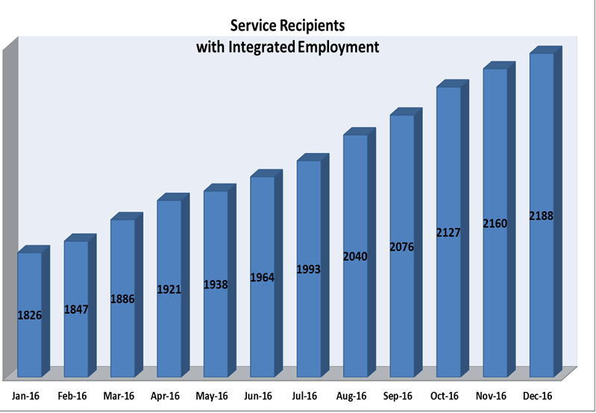
Data on Integrated Employment
Notes:
Data on integrated employment shows the number of consumers who are in integrated employment. Unrelated to who is paying them or how much they get paid, these folks have real jobs in the community where people without disabilities work.

Slide 23
Competitive Employment
Full-time or part-time work in the competitive labor market
Integrated setting
Compensated at or above minimum wage, but not less than customary wage
Same benefits offered as individuals who do not have a disability

Slide 24
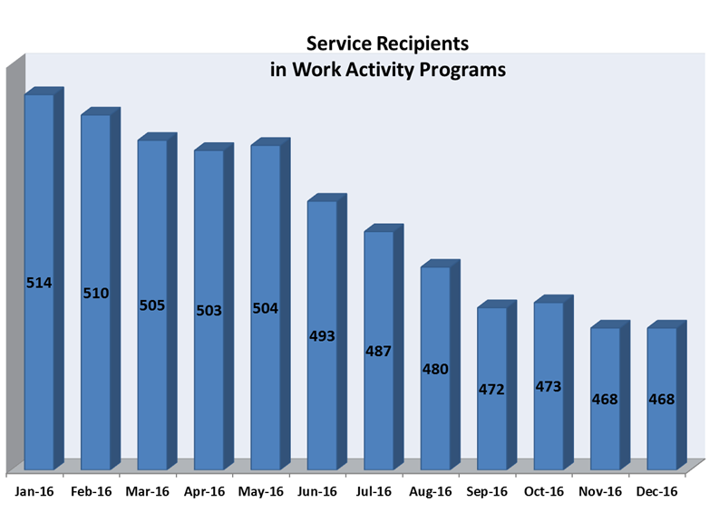
Data on Sheltered Workshop Decrease
Notes:
Department of Justice is suing states to close sheltered workshops
-Oregon, Delaware, and Rhode Island

Slide 25
Selecting the Appropriate Support
Following Directions
Dress/Hygiene
Time Management & Employer Expectations
Work Tasks
Productivity
Quality of Work
Communication & Socialization
Mobility & Transportation
Community Safety

Slide 26

Employment Support
Supported Employment Programs
  20% of hours worked per month (Individual)
Tailored Day Services
  7 hours per week
Employment First Programs
  100% support

Slide 27


Working with Job Coach Support

Slide 28

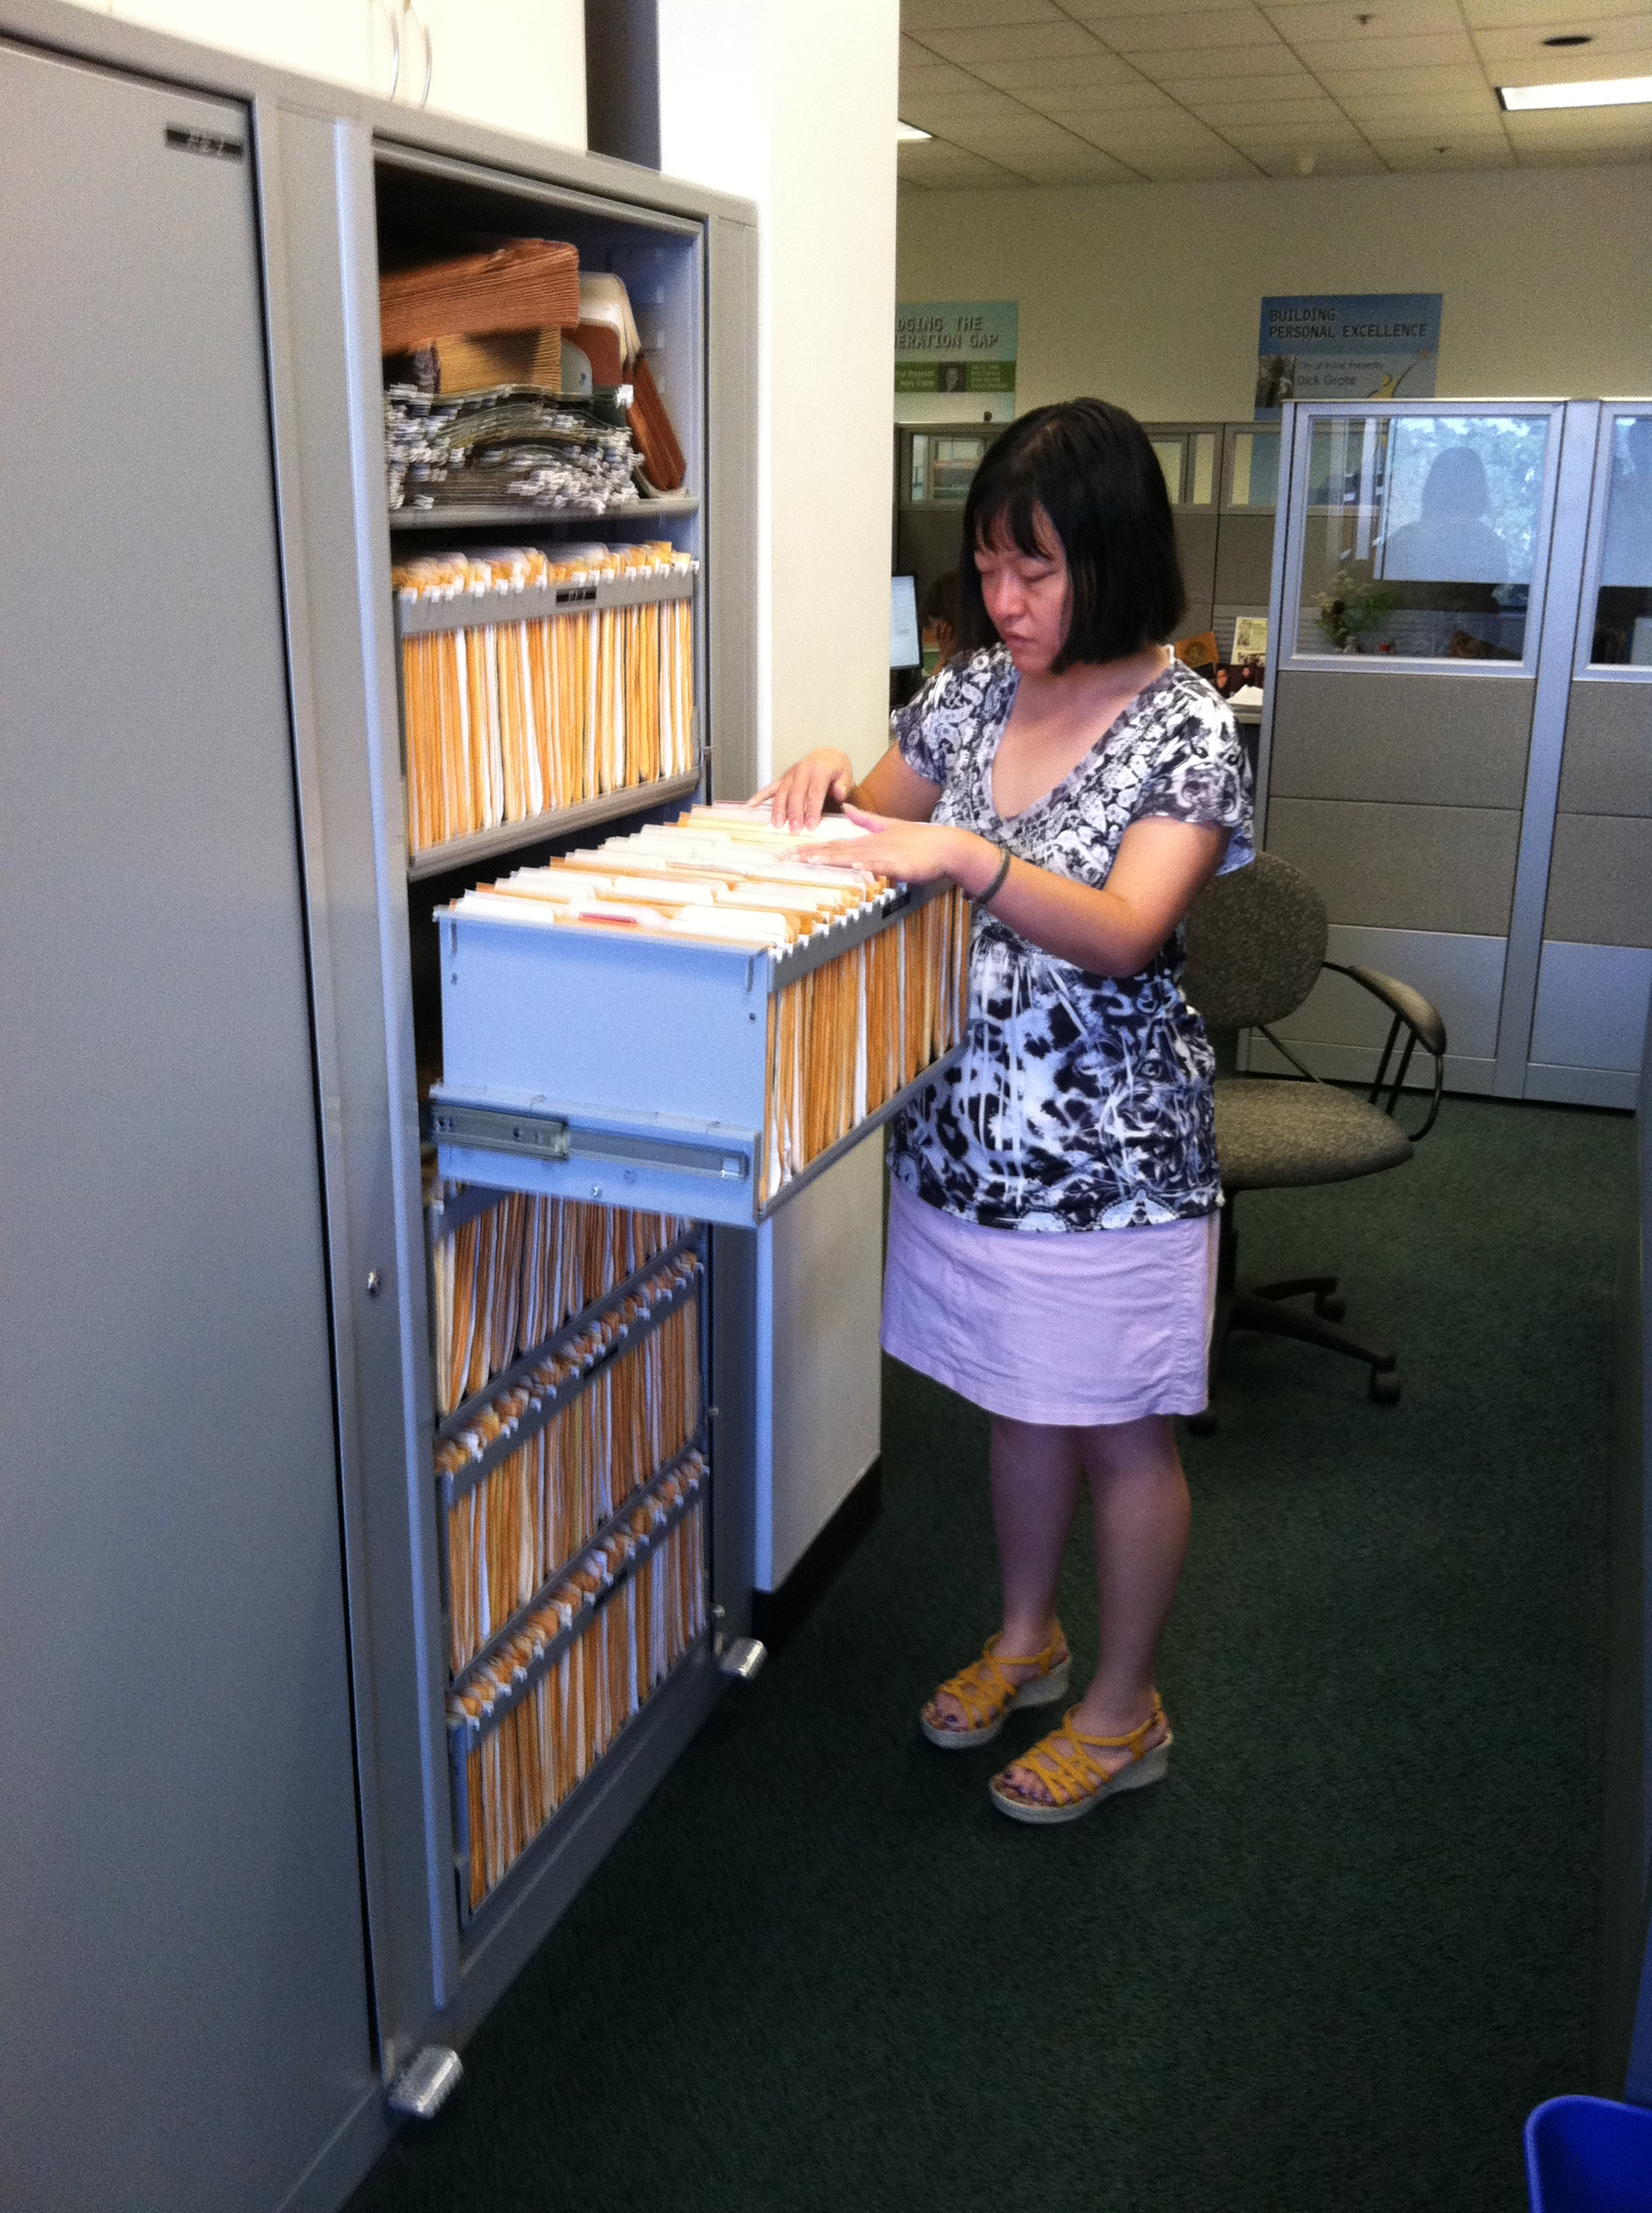

Employees

Slide 29



Person-Centered Planning and Interagency Collaboration builds hope, self-confidence and trust … ultimately yields quality outcomes in Adult life!
Gillman
Project Search
Children’s Hospital Orange County
C.I.E
Competitive Integrated Employment & Work-Based Learning
Young Adults with IDD
Family
CHOC Staff
Gillman Family Trust
Regional Center of Orange County
Integrated Resources Institute
Santiago Canyon College
UCI Technology in the Workplace Program
Department of Rehabilitation
Transportation Options

Slide 30

Happy Co-Workers!

Slide 31
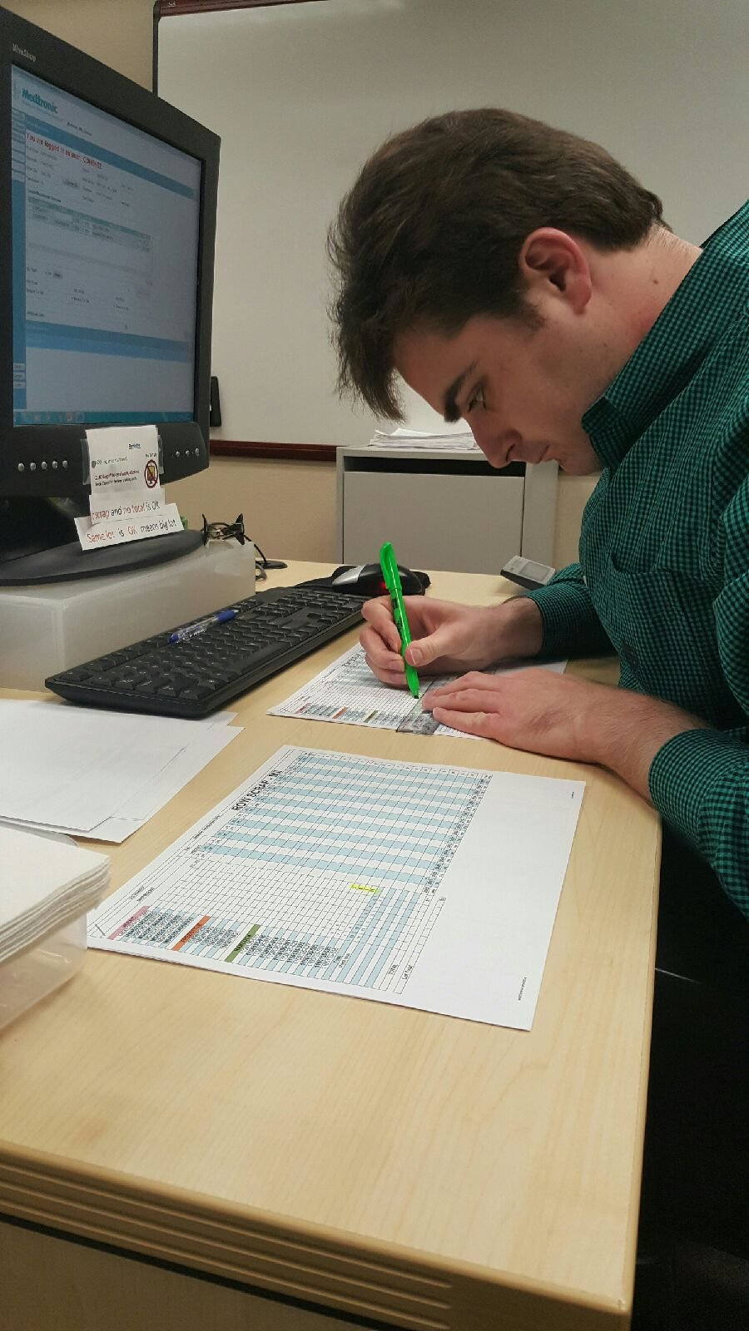
Person-Centered Planning and Interagency Collaboration builds hope, self-confidence and trust … ultimately yields quality outcomes in Adult life!
Project Search Medtronic
Travis
Competitive Integrated Employment
Family
Medtronic
Regional Center of Orange County
Irvine Unified School District
Department of Rehabilitation
Transportation Options
ABLE Account

Slide 32
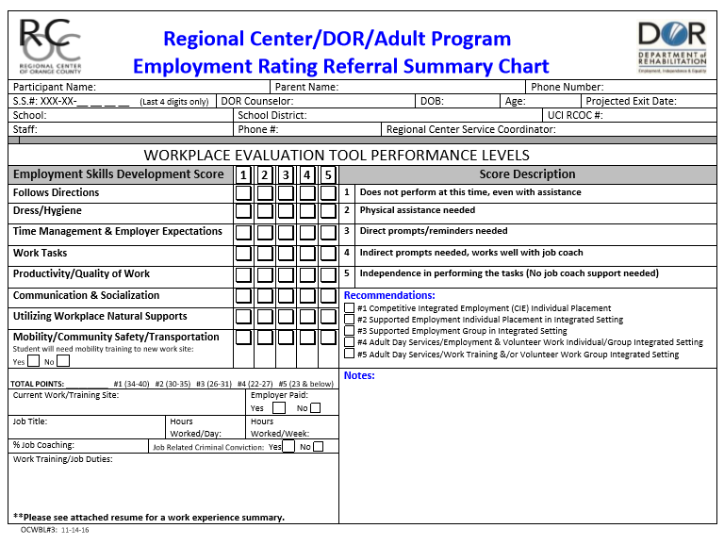

Slide 33
















Top Employers

Slide 34
Next Steps?
Invite your Service Coordinator to IEP/ITP meetings
Include employment related goals in IEP/ITP and IPP
Continue to gather information regarding available options for support and services

Slide 35

Failure to focus on Social Security benefits during transition is just not a missed opportunity, but may also cause harm when students and family members are not educated about or prepared for the effect of earnings on cash benefits and medical insurance*
*National Council on Disability
October 28, 2008

Slide 36
Supplemental Security Income (SSI) Benefits
In 1972, federalization of state welfare programs for aged, blind and disabled
Needs-based
Resource limits: $2000 for individual, $3000 for couple
Paid out of general federal tax dollars
Monthly payment fluctuates with income
Payer of last resort
Medicaid (Medi-Cal): Immediate eligibility

Slide 37
Basic Eligibility Requirements for SSI
Disabled; or
Blind (20/200 or less in better eye with glasses or field of vision less than 20 degrees); or,
Aged 65 or older; and
  Meet the income and resource tests; and
  Certain citizenship or residency requirements
  File an application

Slide 38
SSI and Resources
$2,000 resource limit ($3,000 for couple) to remain eligible for SSI
  Resources are counted at beginning of month
  May not be eligible to receive SSI for any month that resources exceed limit

Slide 39
SSI Cost of Living Adjustments for 2017
2016 2017
SSI Federal Payment Standard: Individual $ 733/mo. $ 735/mo.
Couple $ 1,100/mo. $ 1,103/mo.
2016 2017
SSI Resources Limits: Individual $2,000 $2,000
Couple $3,000 $3,000
2016 2017
SSI Student Exclusion: Monthly limit $1,780 $1,790
Annual limit $7,180 $7,200

Slide 40
SSI & Resources
What counts?
What does NOT count?
Cash, stocks, bonds
Land
Life insurance (with face value over $1,500)
“Deemed” resources of parent or spouse
Inheritance
House you live in
Car you drive
Scholarships, grants
Money in an approved PASS
Retroactive SSI/SSDI payments (for up to 9 months)
Funds in Special Needs Trust

Slide 41
Social Security’s Definition of Disability for Children Under Age 18
An individual under 18 is “disabled” if he or she has a medically determinable physical or mental impairment or combination of impairments which:
  Results in marked and severe functional limitations; &
  Can be expected to result in death; or
  Has lasted or can be expected to last at least 12 months

Slide 42
Common Myths and Fears
If I go to work I’ll lose my cash benefits
I’d love to work but I can’t afford to lose my
Medi-Cal / Medicare
If my disability worsens and I can’t continue to work, I won’t be able to get back on benefits
I can’t work…I get disability!

Slide 43
SSA Work Incentives
Impairment Related Work Expenses
Student Earned Income Exclusion
Plan to Achieve Self-Support
Easy Back-On
Individual Development Account

Slide 44
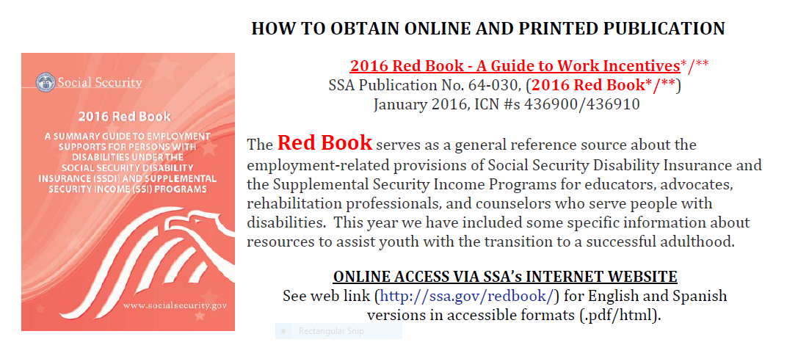

Slide 45
SSA Work Incentives
Impairment Related Work Expenses
Student Earned Income Exclusion
Plan to Achieve Self-Support
Easy Back-On
Individual Development Account

Slide 46
Impairment Related Work Expenses (IRWEs)
Related to disability, paid for by beneficiary, and necessary for work
  Examples:
    Personal assistance services
    Assistive technology
    Prescription drug co-payments
No fixed list

Slide 47
Individual Development Account (IDA)
An Individual Development Account, also known as an IDA, is a savings account for low-income workers that can be used for small-business development, higher education, or the purchase of a first home. Each time you make a deposit, the IDA program sets aside money that will be used for your designated purpose when you reach your savings goal. The money the IDA program sets aside is called a match. Most IDA programs have a match that is between 1 – 4 times the size of your deposit. For example, if you are in an IDA program with a 2:1 match, each time you deposit $25, your program sets aside an additional $50.

Slide 48

MATTHEW

Slide 49
WILLIE

Slide 50
Benefits Planners & Resources are available through:
RCOC (Suzanne Butler, Instructor/Coordinator, ID Program RCOC)
Department of Rehabilitation
DB101 Website
Work Incentive Planning & Assistance Certified Planners (WIPAs)
SSA Red Book

Slide 51

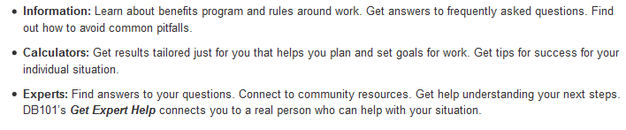
https://ca.db101.org/about.htm

Slide 52
WIPA
Work Incentive Planning & Assistance

Slide 53
What is WIPA?
WIPA stands for Work Incentives Planning and Assistance.
It is funded exclusively by the Social Security Administration (SSA).
A Certified Planner helps to provide accurate and timely information about the impact of earnings on your SSI or SSDI cash and healthcare benefits.
Work incentives allow you to keep your cash and healthcare benefits, at least temporarily, as you work toward earning more money through employment!

Slide 54
Who is Eligible for WIPA Services?
Individuals with disabilities age 14 through retirement age, who are currently receiving one or more of the following based on disability:
SSI (Supplemental Security Income)
SSDI (Social Security Disability Insurance)
CDB (Childhood Disability Benefits)
DWB (Disabled Widow(er) Benefits)
OR Individuals whose cash benefits have been suspended recently due to earned income
AND meet one of these criteria:
Currently working or self-employed
Currently looking for work
Seriously considering looking for work

Slide 55
WIPA Services
Project Independence WIPA SERVICES are available to ANYBODY who receives a Social Security benefit based on a disability between the ages of 14 & full retirement and lives in Orange County, San Bernardino County, Kern County or Inyo County.

Slide 56
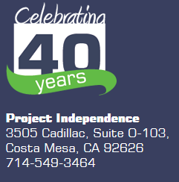
Where is WIPA?
WIPA is located at the Project Independence Administrative Office in the City of Costa Mesa.
Call (714) 549-3464 to speak with a CWIC (Community Work Incentives Coordinator) and/or make an appointment.

Slide 57

WIPA
Work Incentives Planning and Assistance
Juliana Beason, CWIC
(Community Work Incentives Coordinator)
Project Independence, WIPA (Work Incentive Planning & Assistance)
How working impacts Supplemental Security Income (SSI)

Slide 58

http://www.treasurer.ca.gov/able/
Join the CalABLE
Mailing List

Slide 59
CalABLE
The CalABLE program will open up life-improving opportunities for people with disabilities and their families. Contributions to an ABLE account, currently limited to $14,000 per year, can be made by family, friends, or the beneficiary themselves. The account’s earnings are allowed to accumulate tax-free, and the withdrawals, provided they are applied to qualifying disability expenses, are tax-free. We hope to make ABLE accounts available by summer 2017.

Slide 60
Suggestion...
Keep Current on New ABLE Developments
Because ABLE is a new program...
changes, additions and updates are
being made frequently. Make sure
you have the latest information by:
Routinely checking the Websites
Participating in first run & archived webinars
Getting on the mailing lists
Asking questions
ABLE National Resource Center
www.ablenrc.org
CalABLE Website
http://www.treasurer.ca.gov/able/
Disability Benefits 101
https://ca.db101.org/about.htm

Slide 61


Transition Workshop Materials
www.rcocdd.com
Quick Links on the Main Page
Transition Planning
Available 1 week after presentation

Slide 62
Link to Orange County Work Based Learning System
http://www.rcocdd.com/frc/transition-planning/

Slide 63
Thank you for your Participation!
Janis White
Linda O’Neal
Arturo Cazares

Slide 64
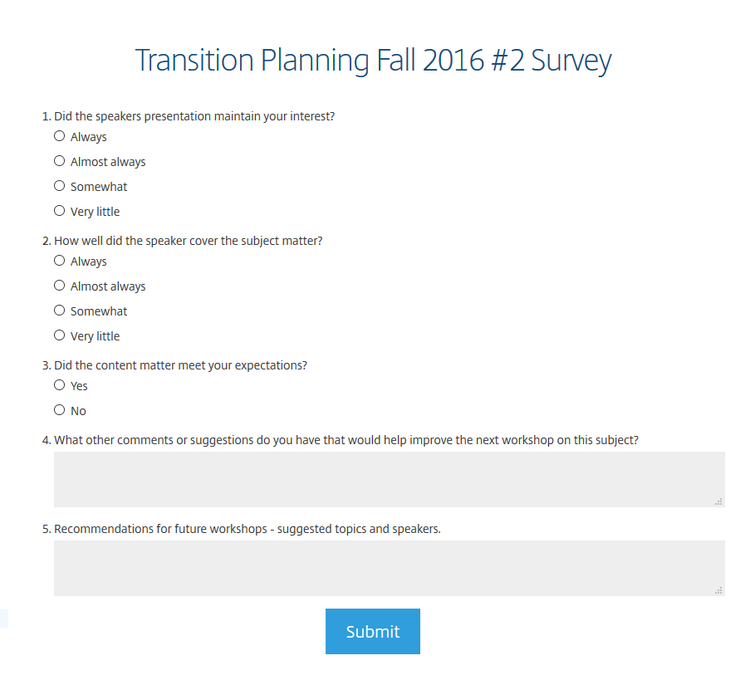
Transition Planning Webinar Survey January 2017
Please take a few minutes to give your feedback on today’s webinar...

Slide 65
QUESTIONS
Competitive Integrated Employment
??????

